Slide 1
NAPPC Pesticide Education Task Force
2021-2022

Slide 2
Use pesticide registration and regulation as a tool to protect and promote pollinator health.
Objective of the Pesticide Education Task Force:

Slide 3
Pesticide Applicators Farmers and Ranchers Homeowners Educators and Extension Agents State Departments of Agriculture General Public Tribes
Audiences to reach:

Slide 4
Task Force Focus Areas:
Help all audiences read labels to protect pollinators
Increase accurate reporting of bee kill incidents
Educate all about EPA Risk Assessment

Slide 5
MORE Task Force Objectives:
• Create a cohesive, active Task Force • Invite guest speakers to TF meetings to help with various priorities. • Include State and Tribal Pollinator Protection Programs (P3s and MP3s)

Slide 6
Task Force Focus Accomplishments:
Create a cohesive, active Task Force
Regularly scheduled meetings – met monthly
Added new representation from strategic partners
Presentations from outside experts to better understand issues
Operated with sub-committees
Used Pollinator Week for outreach

Slide 7
Task Force Focus Accomplishments:
Help ALL read labels to protect pollinators
Created and reviewed a graphic card to explain how to read a label to protect pollinators
Distributed 10,000 copies of graphic card
NASDA newsletter
Bee Friendly Farming Newsletter
Pesticide Safety Education Program
NAPPC Website
NW IPM Center
Extension Foundation
Extension MP3 Working Group – Oregon State
Pollinator Week Handout
American Mosquito Control Association

Slide 8
How to Read a Label Card

Slide 9
Task Force Focus Accomplishments:
Help Vector Borne Disease Control be effective without harming pollinators.
Created three cards for specific audiences
In review and design phase
Based on NAPPC White Paper - Ginsberg

Slide 10
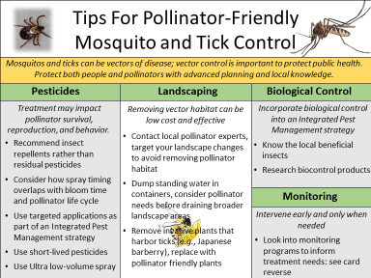
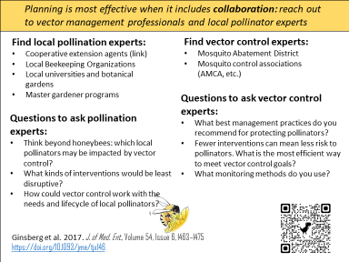
For Managers of HOA’s, multi-family dwellings, etc.

Slide 11
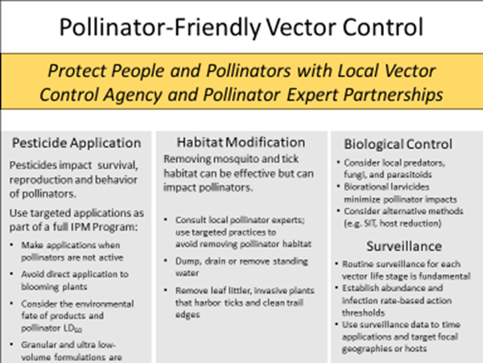
For professional applicators

Slide 12
For homeowners and the public

Slide 13
Task Force Focus Accomplishments:
Educate all about EPA Risk Assessment
Created PowerPoint presentation for understanding EPA responsibility and process for pesticide registration
Will be completed and presented by November
Works to correct misinformation often repeated in discussions of pesticides

Slide 14
Task Force Focus Accomplishments:
Increase accurate reporting of bee kill incidents
Met with successful states (North Carolina and North Dakota) to understand efficient, well-communicated incident reporting
Presenting to upcoming American Beekeeping Federation/Apiary Inspectors of America joint meeting on recognizing and reporting bee kills
Linking to existing material (HBHC)
Accurate photos supplied to TheBeeMD diagnostic tool

Slide 15
2022-2023 Continue current focus and add:
New organizations and experts
Endangered Species Act focus
“Keep the ball moving forward”

