Slide 1
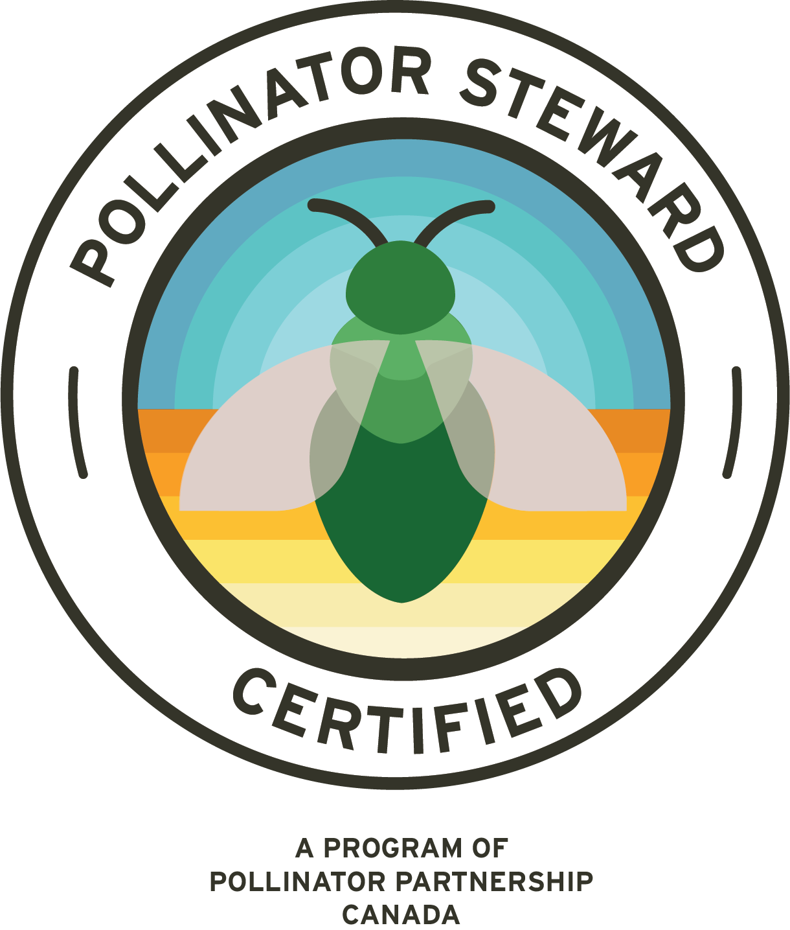

Pollinator Steward Certification
Module 5a: Habitat Creation
Yards, Gardens, and Balconies
Tuesday, March 11th, 2025
Anthony Colangelo
Pollinator Partnership
Sara Wittenberg
Pollinator Partnership
www.pollinator.org
stewards@pollinator.org

Slide 2
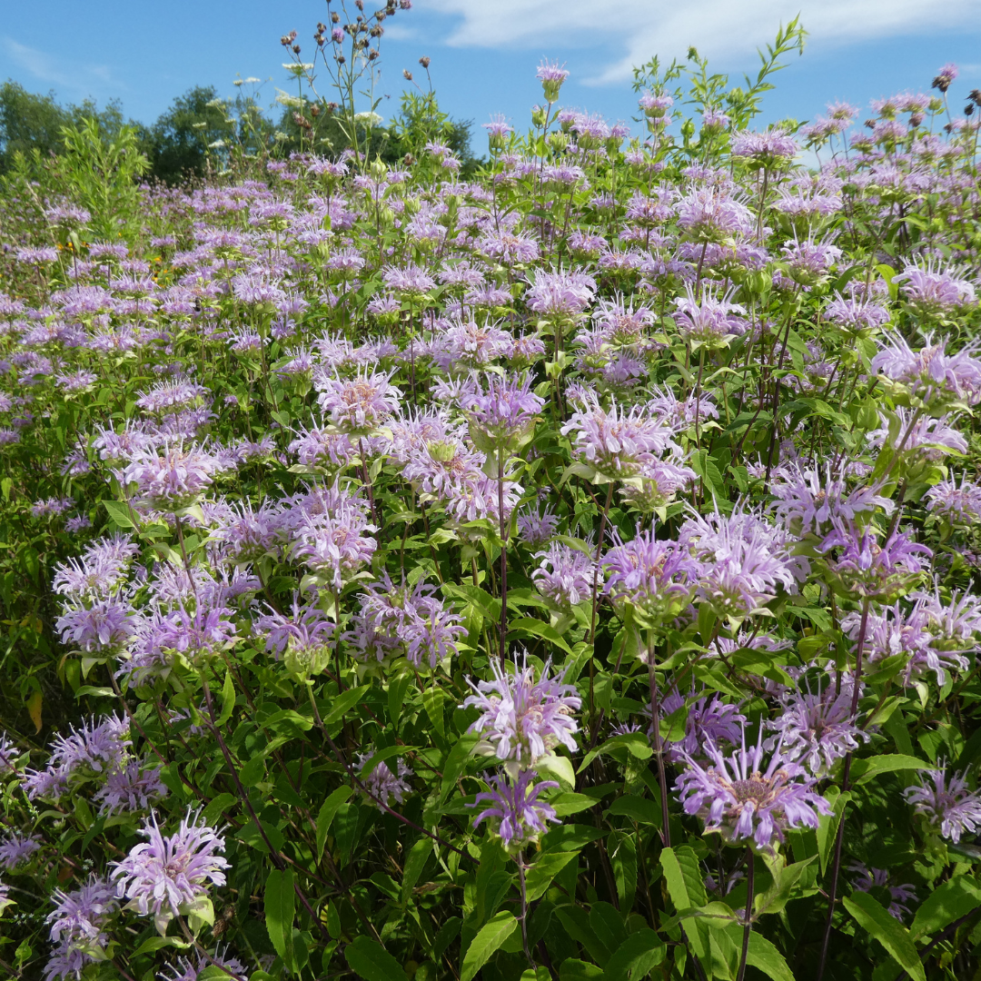
Housekeeping:
Recordings will be shared and be available until December 31st, 2025
Closed captioning is available – enable in your controls.
Please put questions in the Q&A box; UPVOTE questions you like!
Questions for panelists will be answered at the end of the session.
Contact stewards@pollinator.org for registration issues, questions, etc.
Engage in respect and kindness with each other in the chat.
We suggest that you write down in point form or 1-2 sentences the key takeaways from each training while you are attending live.
S. Buchmann

Slide 3
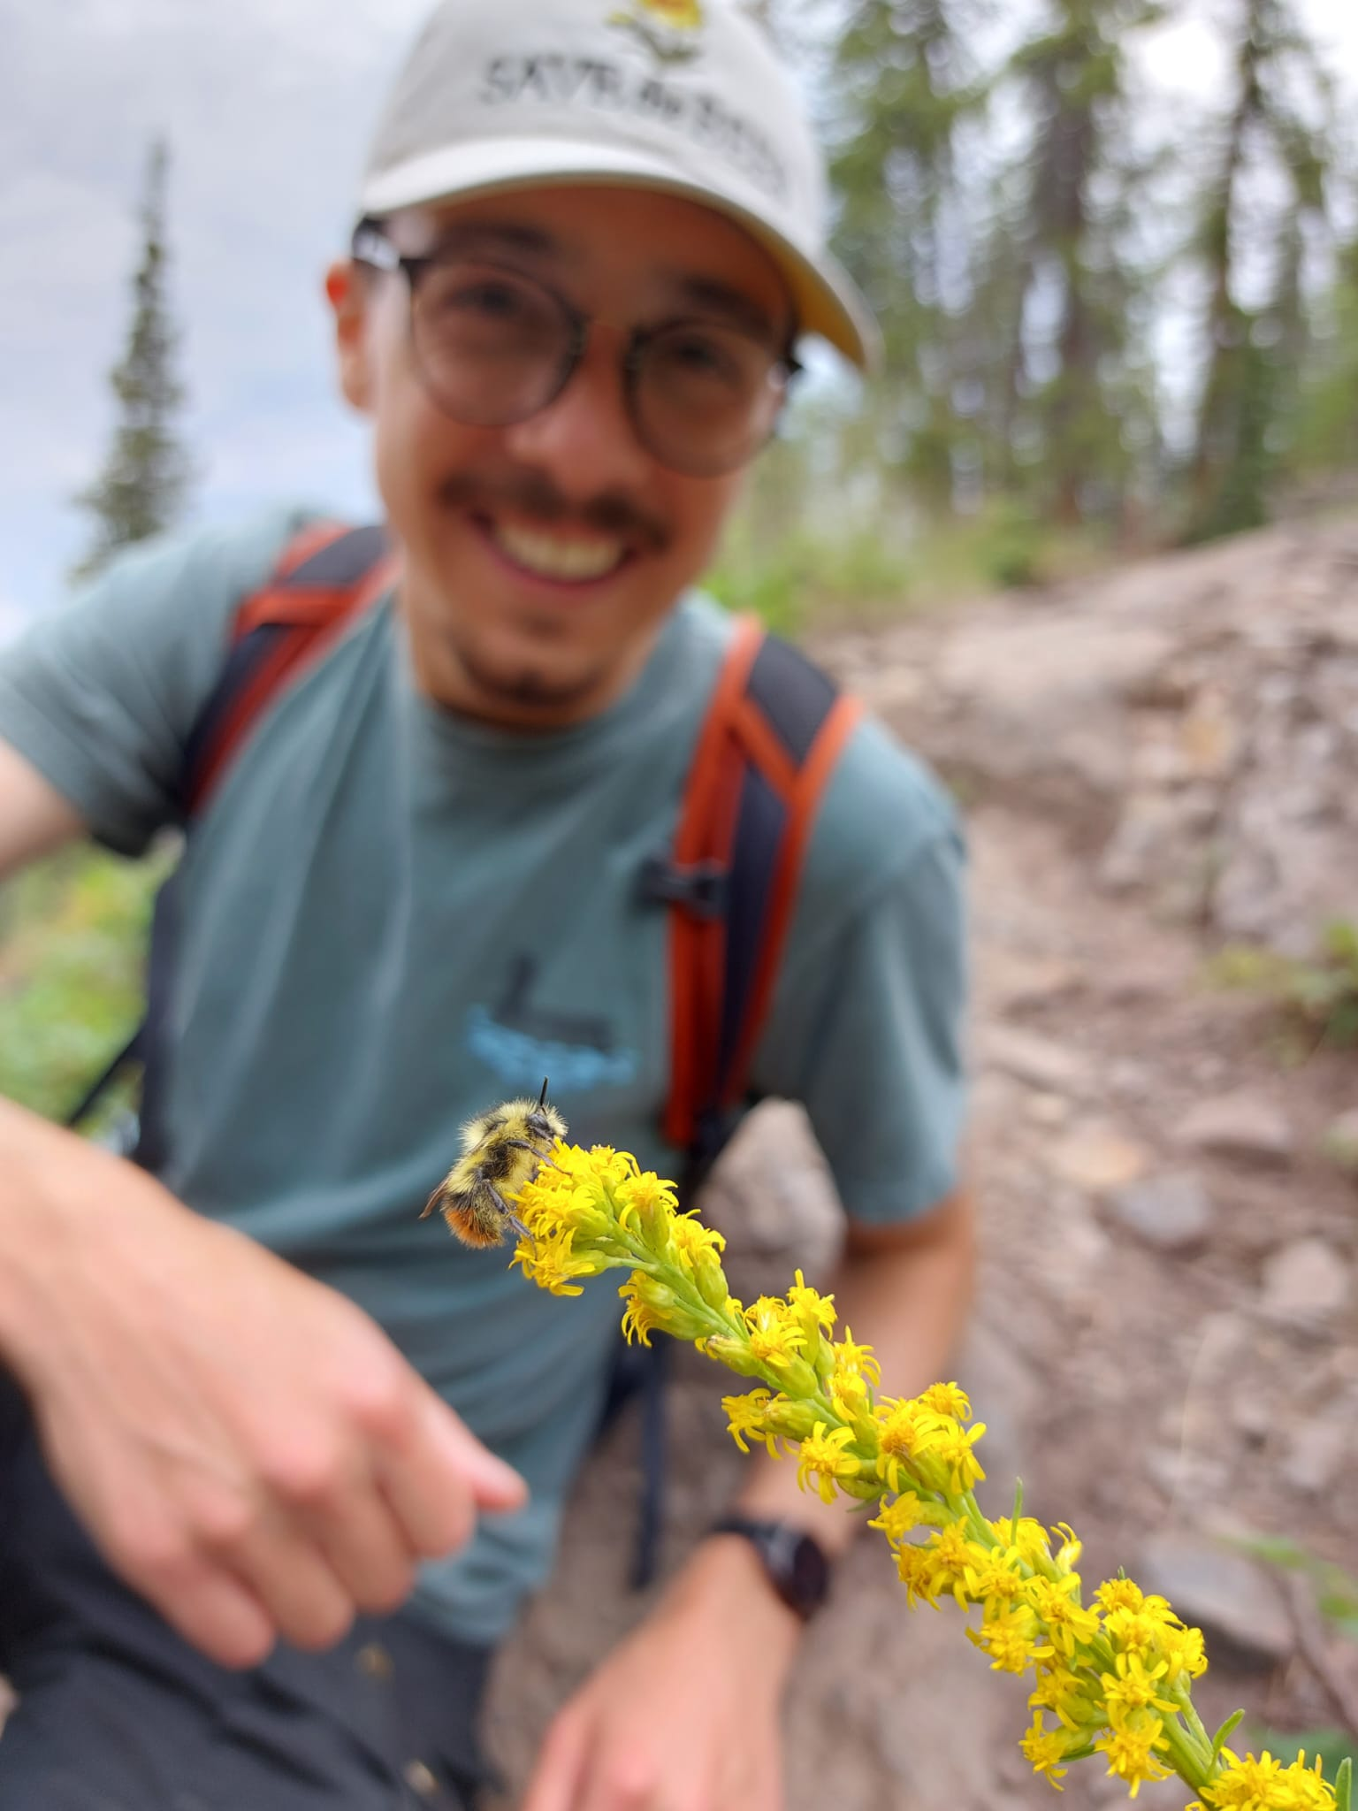
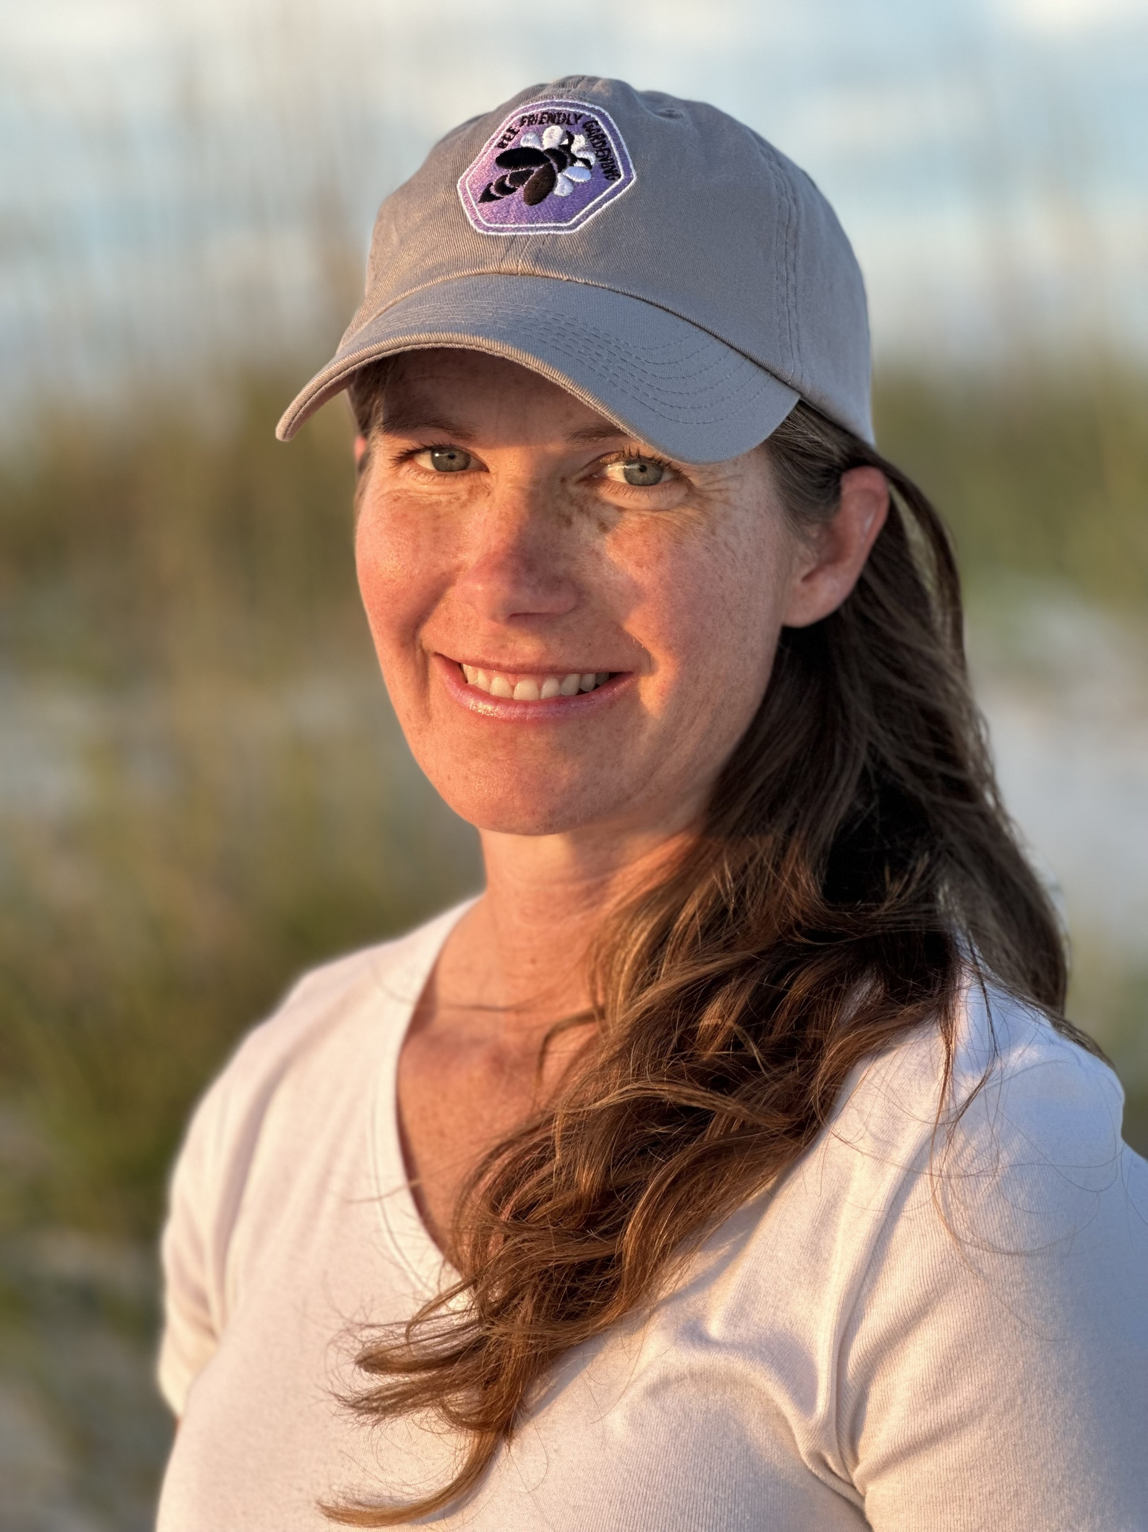
Tonight's Speakers!
Anthony Colangelo
Outreach and Education Specialist
Pollinator Partnership
Sara Wittenberg
Bee Friendly Garden Manager
Pollinator Partnership
S. Buchmann

Slide 4
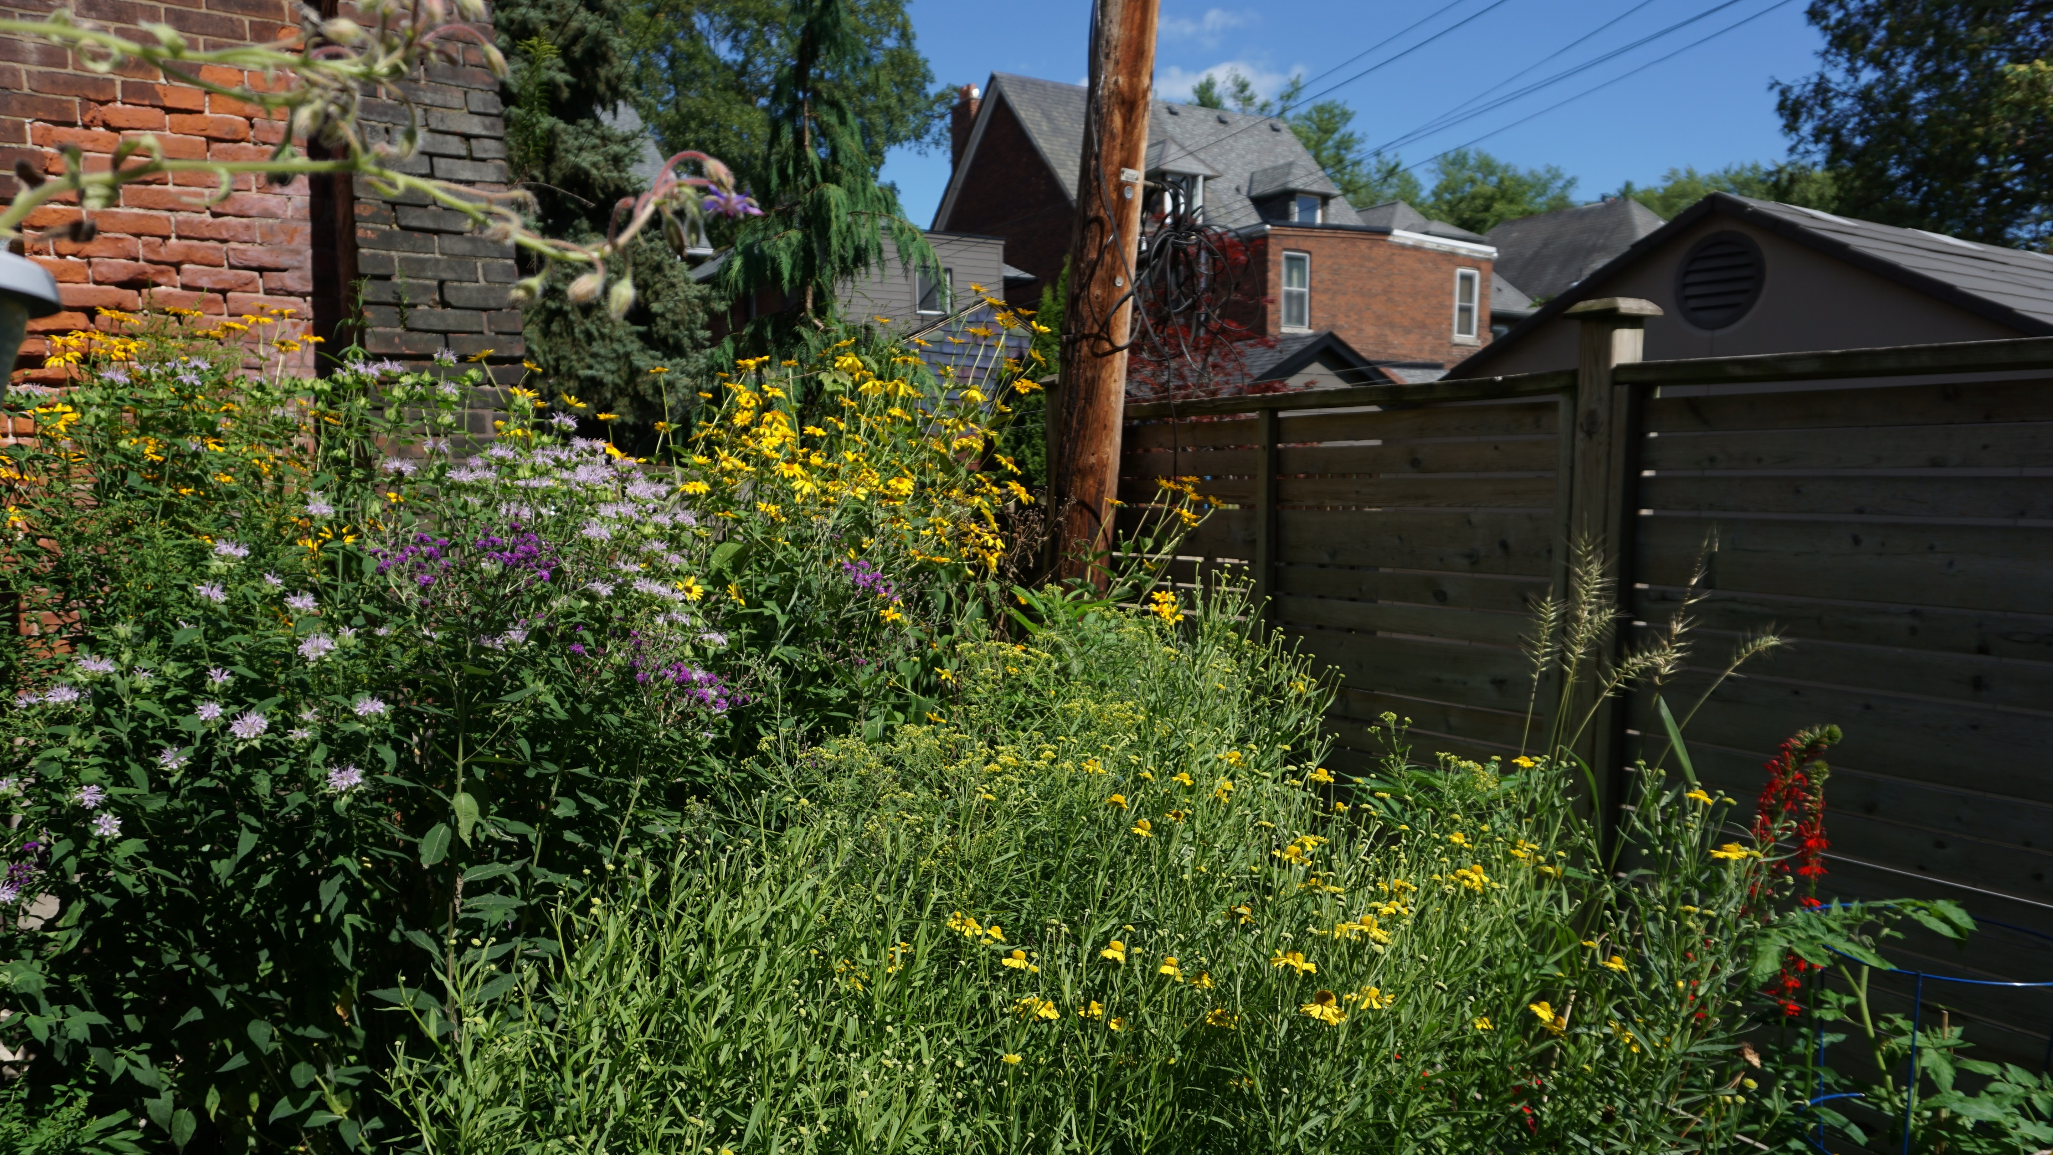
Gardening at Home

Slide 5
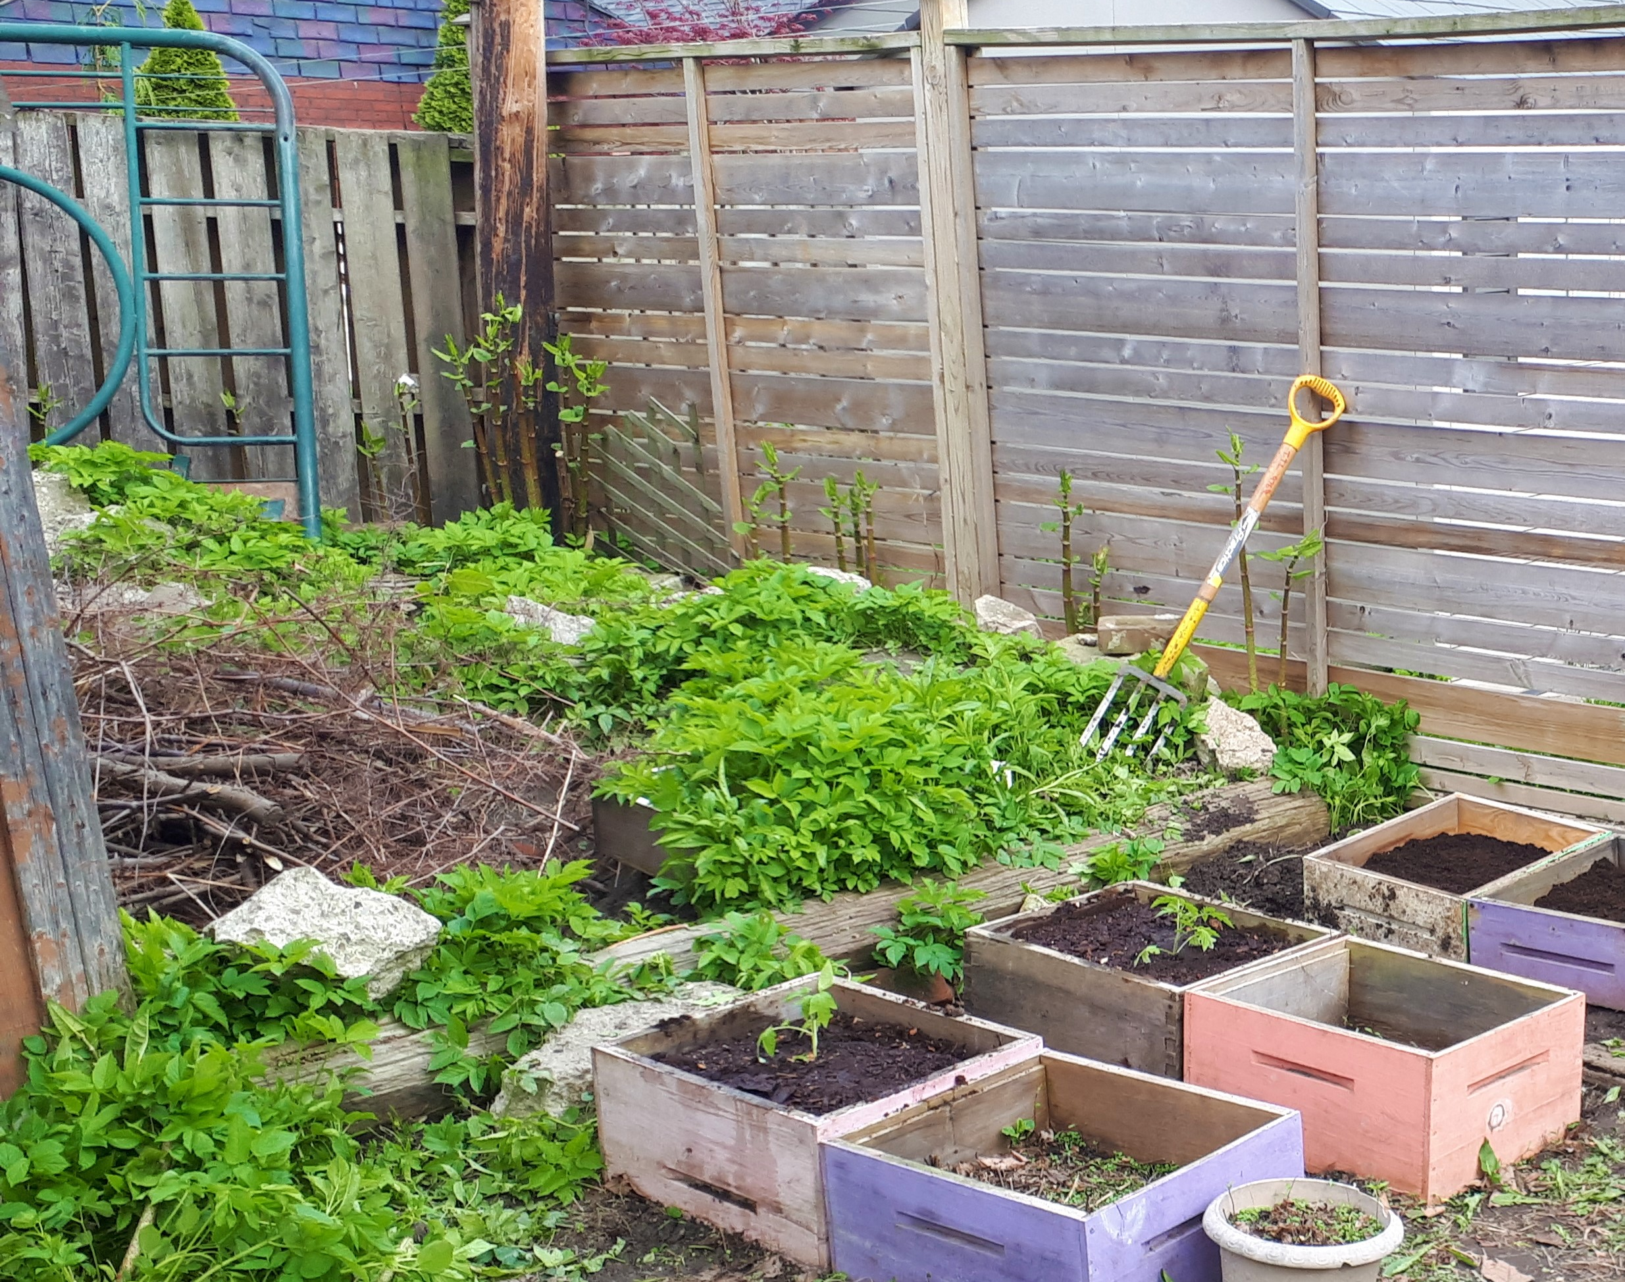
What/who are you starting with?
Who would you like to control?
Who would you like to thrive?
What additions do you need?
Organize your timeline with the seasons

Slide 7
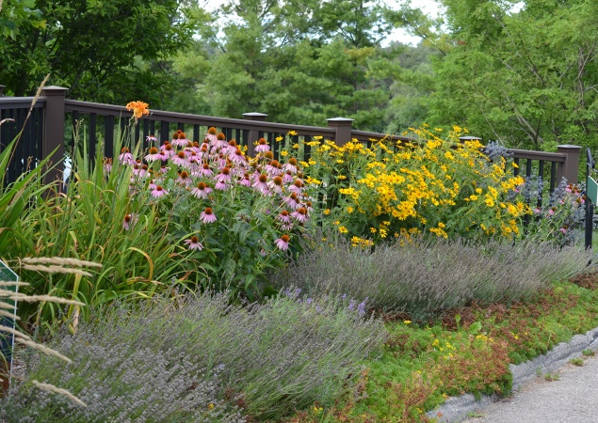
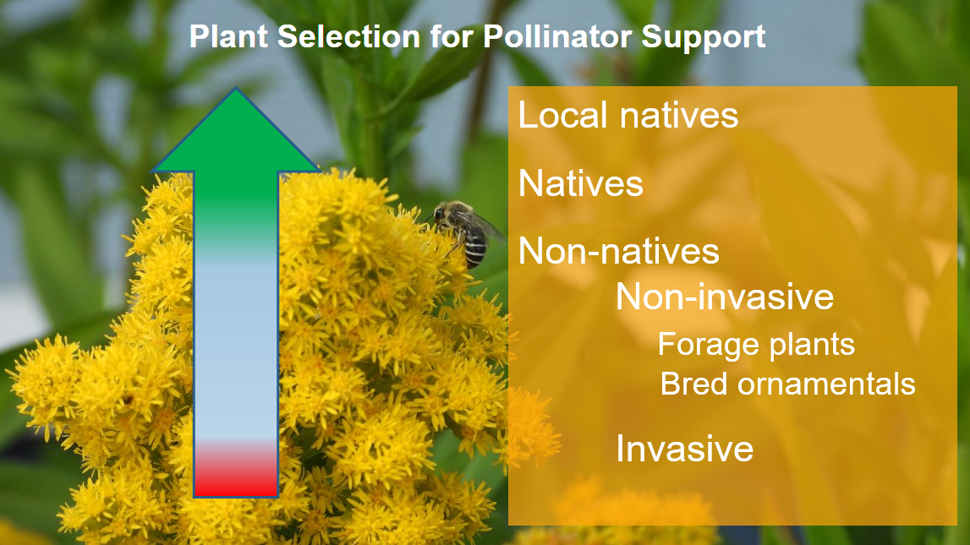
Project Timeline
Understanding pollinator lifecycles so we can plant for them
Know your plants, and plan according to their preferences
  Annual
  Perennial
  Ornamental
  Native

Slide 8
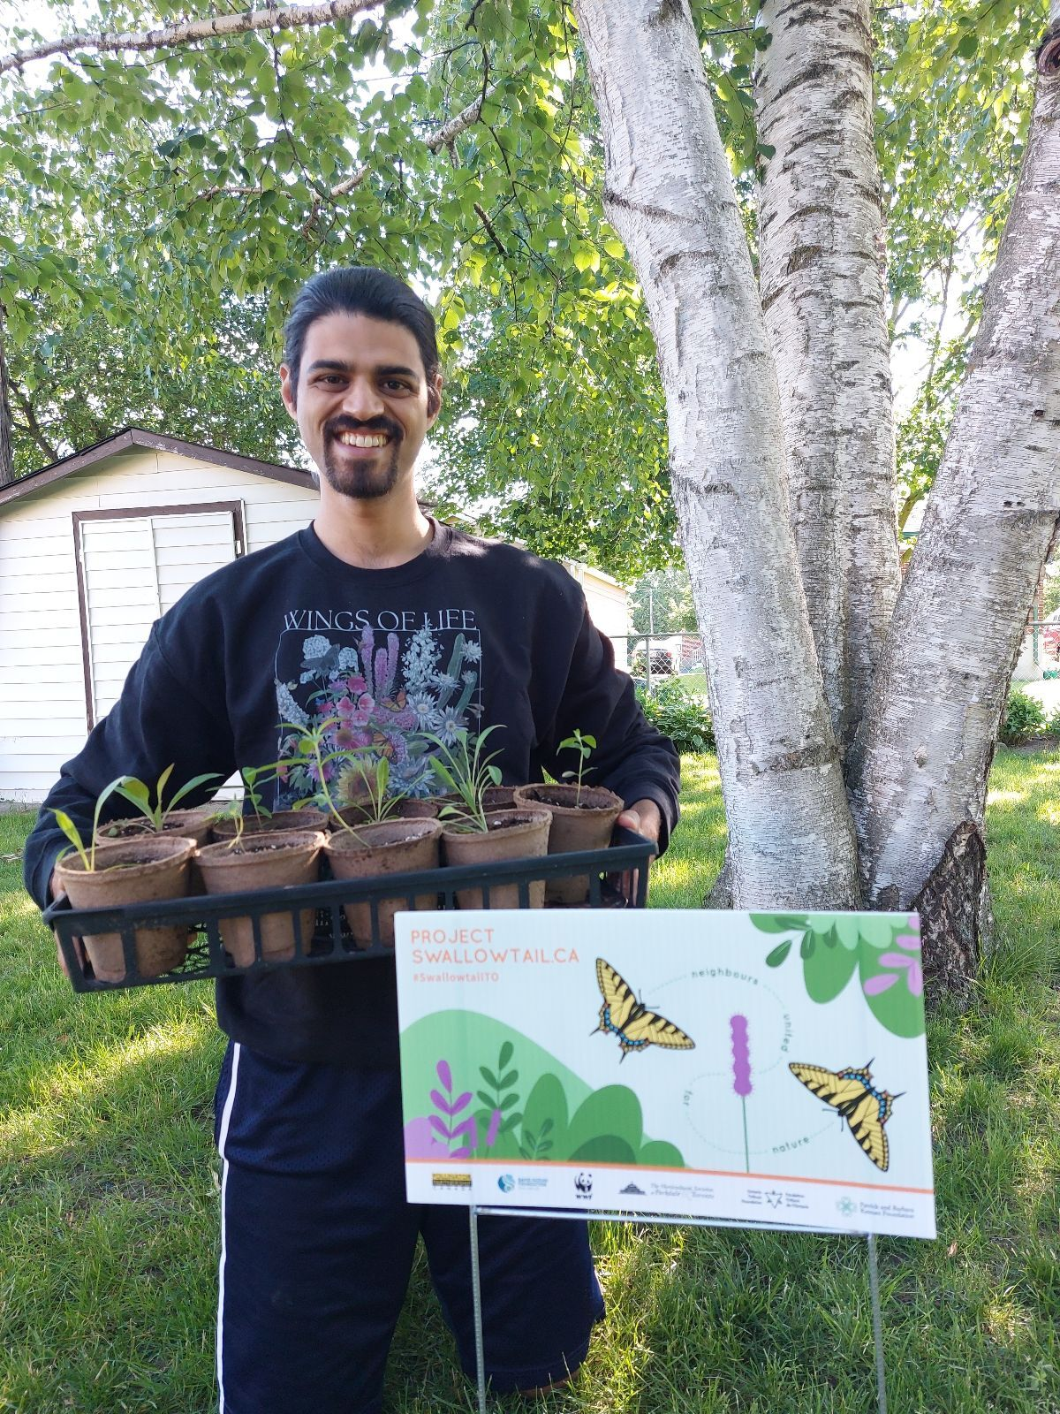
Resources and Funding
Tools
Soil and amendments
Signage
Plants
  Seeds, plugs, pots, trimmings, root remnants, and rescues
  State or Provincial native plant societies
  Libraries
  Garden clubs

Slide 9
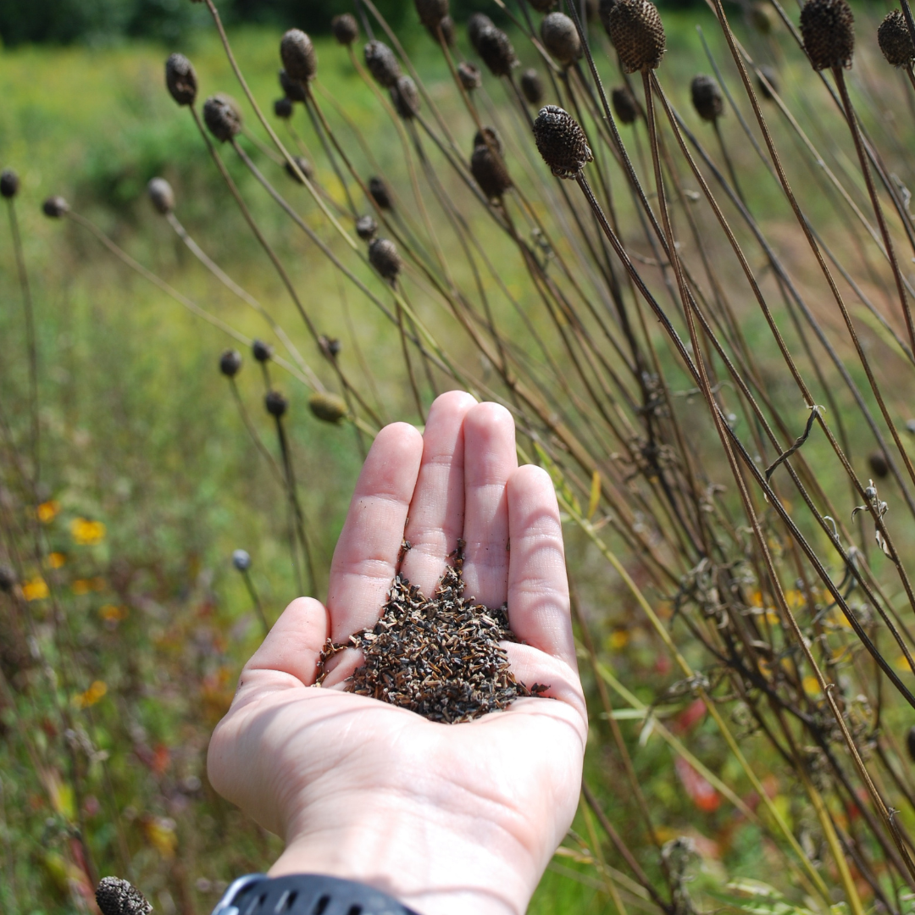
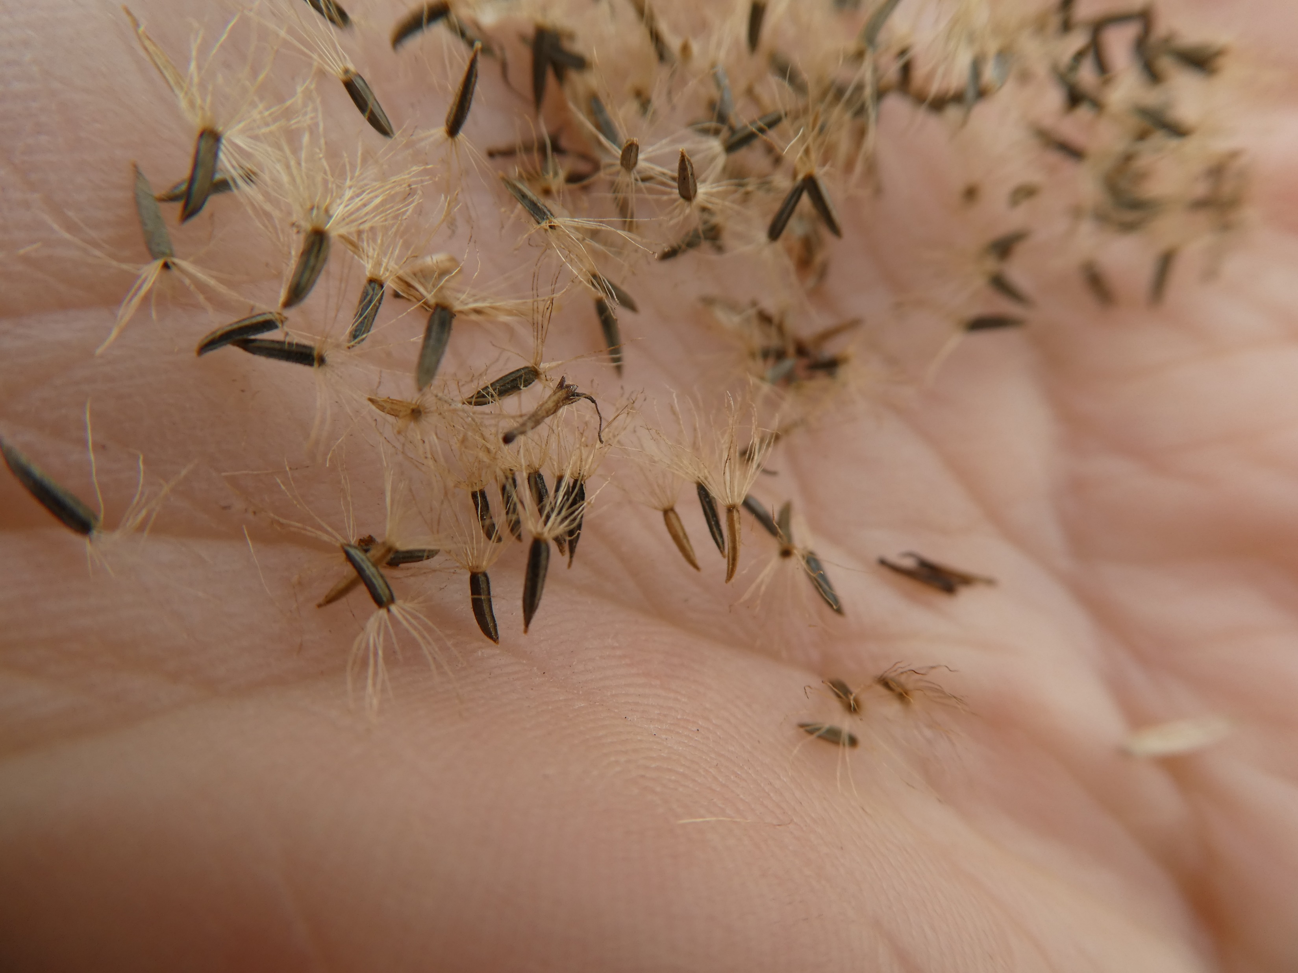

Slide 10
Resources and Funding
Tools
Soil and amendments
Signage
Plants
  Seeds, plugs, pots, trimmings, root remnants, and rescues
  State or Provincial native plant societies
  Libraries
  Garden clubs

Slide 11
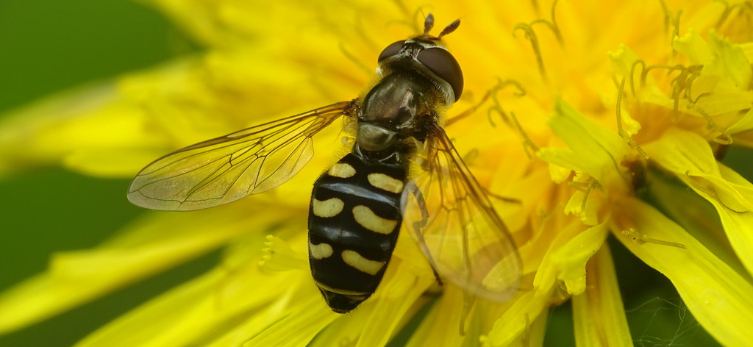
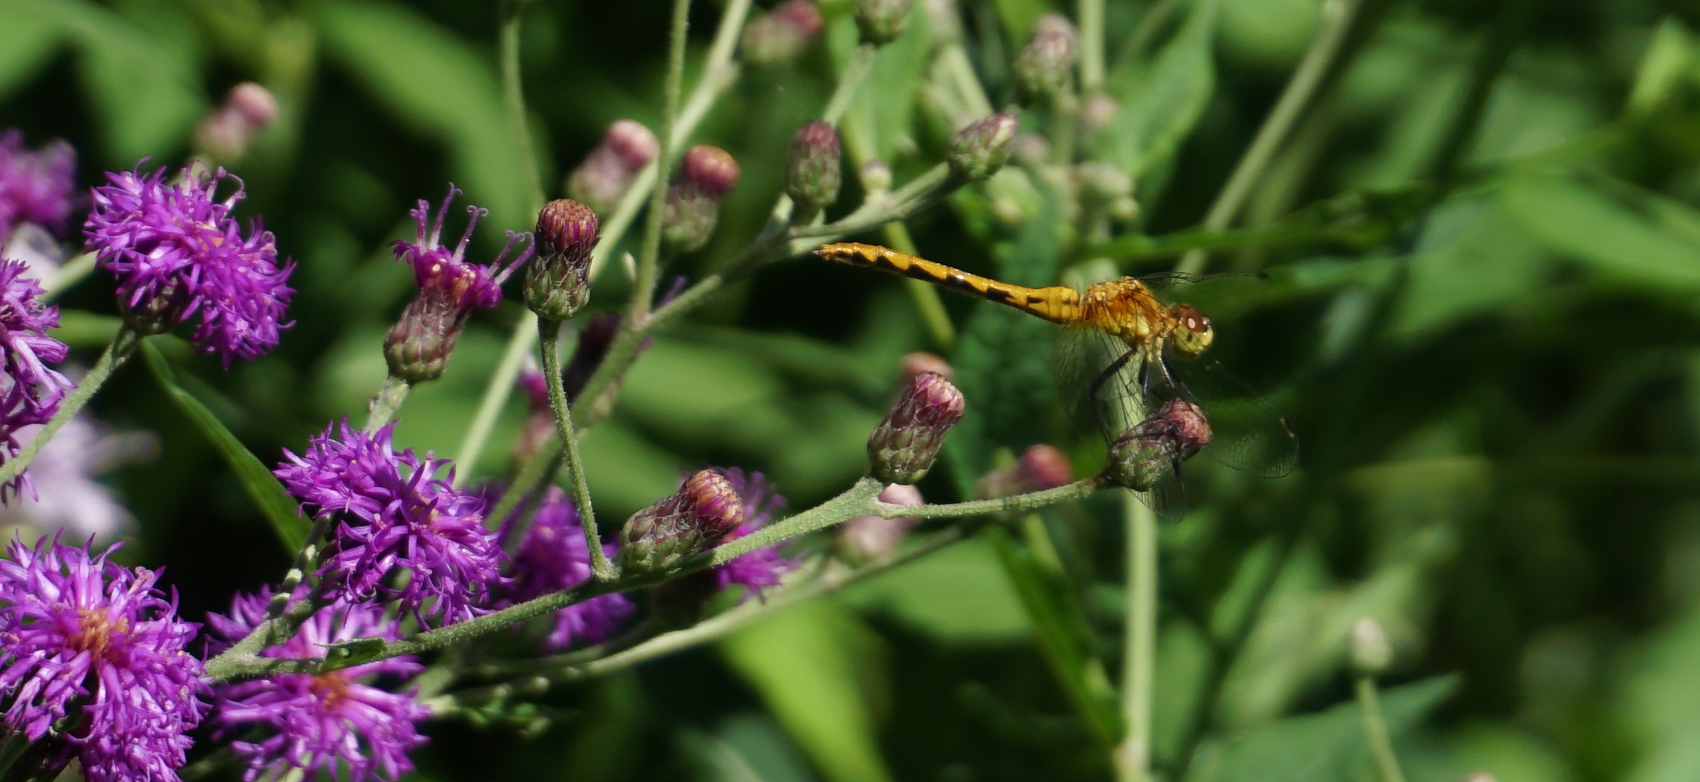
Pesticide, Herbicides, and Fungicides
Pesticides can have lethal or sublethal effects
Herbicides can reduce forage
Fungicides are often part of seed coatings, and more research needs to be done on the impacts
Alternatives include Beneficial insects
  Larvae of hoverflies, lady beetles, dragonflies, wasps

Slide 12
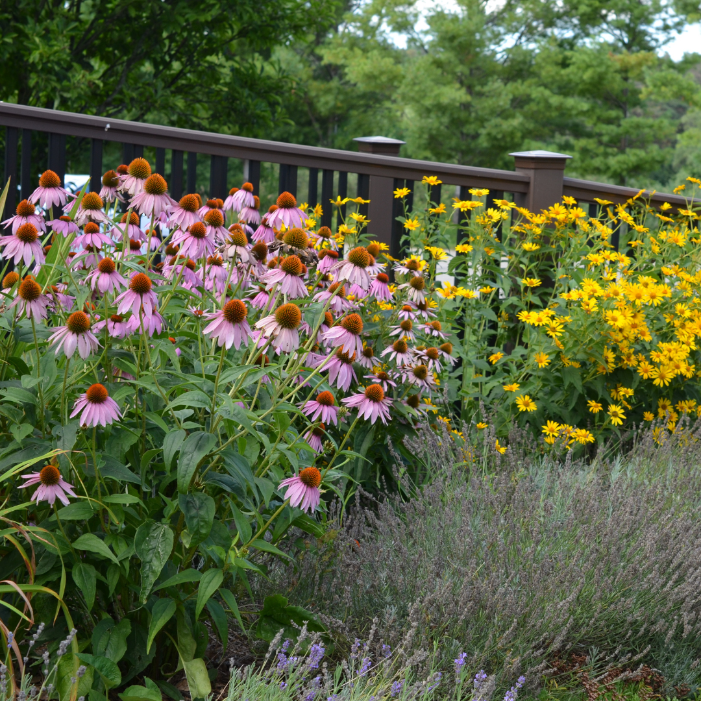
Course Information Page:
The Course Information page will be your homebase for module recordings, updates, and program resources. Login to the Course Information page using the following username and password:
website: https://www.pollinator.org/psc/course-info
username: PollinatorSteward
password: psc2025
Please do not share the username and password as this page is only for registered participants of the 2025 Pollinator Steward Certification program.
S. Buchmann

Slide 13
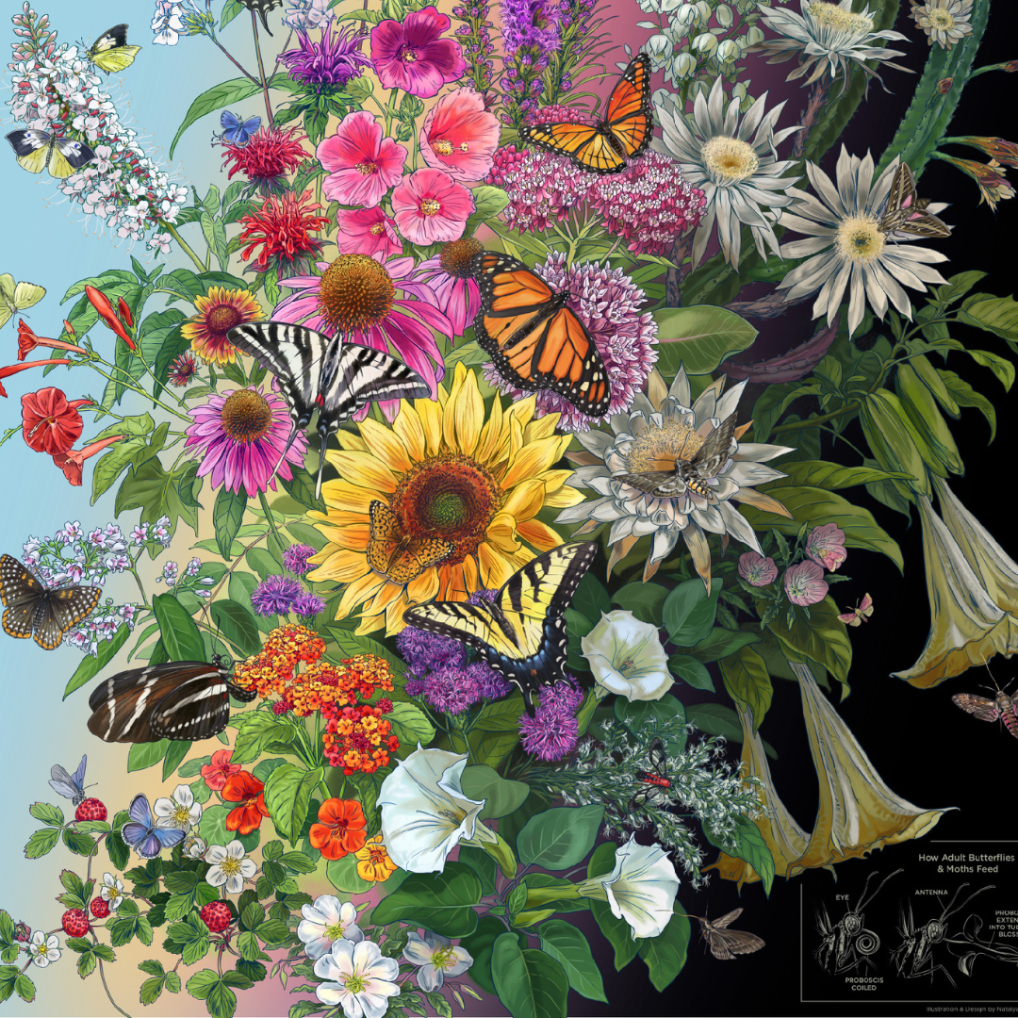
Wrap Up:
Wednesday, March 12th, we will focus on habitat creation on a large scale for those who manage rights-of-way, parks, roadsides, and municipalities.
Thursday, March 13th, we will complete our habitat modules with a focus on supporting pollinators in agricultural landscapes.
For certification, attendance (or later viewing) of ONE of the three habitat sessions this week is required

