Slide 1
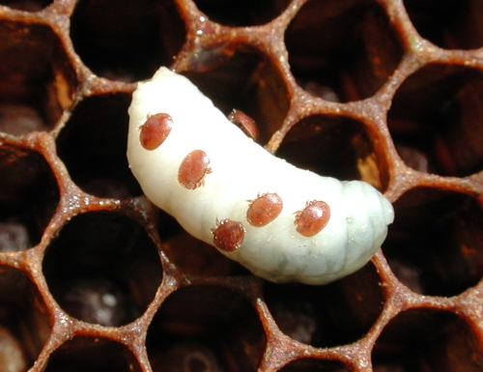
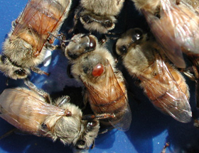
Mite-A-Thon
Date: May 2-17 and August 15-30, 2020
Location: North America
1

Slide 2
Mite-A-Thon: What is it?
Objectives
To raise awareness about honey bee colony Varroa infestations in North America through effective monitoring methods.
To make available management strategies for discussion within bee organizations utilizing Mite‐A‐Thon partner developed information and outreach materials.
Participants
Mite-A-Thon is a tri-national effort to collect mite infestation data and to visualize Varroa infestations in honey bee colonies across North America within a one week window. All beekeepers can participate, creating a rich distribution of sampling sites in Canada, the United States, and Mexico.
Data
Varroa monitoring data will be uploaded to www.mitecheck.com.
2

Slide 3
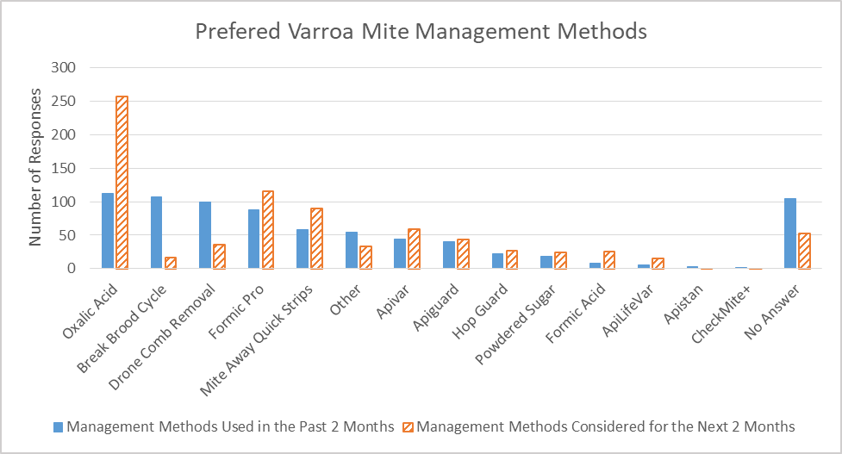
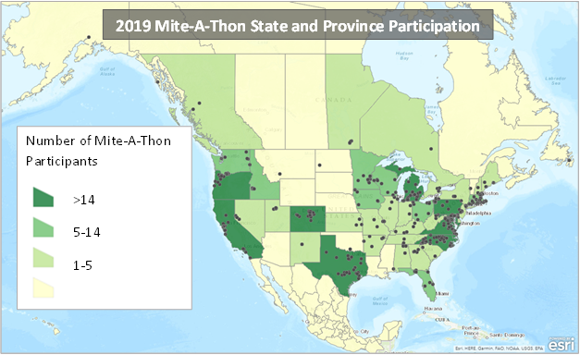
Mite-A-Thon 2019 Recap
Overview:
545 participants
1,842 colonies tested.
14 management methods reported.
Mapping:
Large portions of the country with no reported data.
Almost no participation in the top 3 honey producing states: North Dakota, South Dakota, and Montana.
Need more participation this year, especially from gap areas!
3

Slide 4
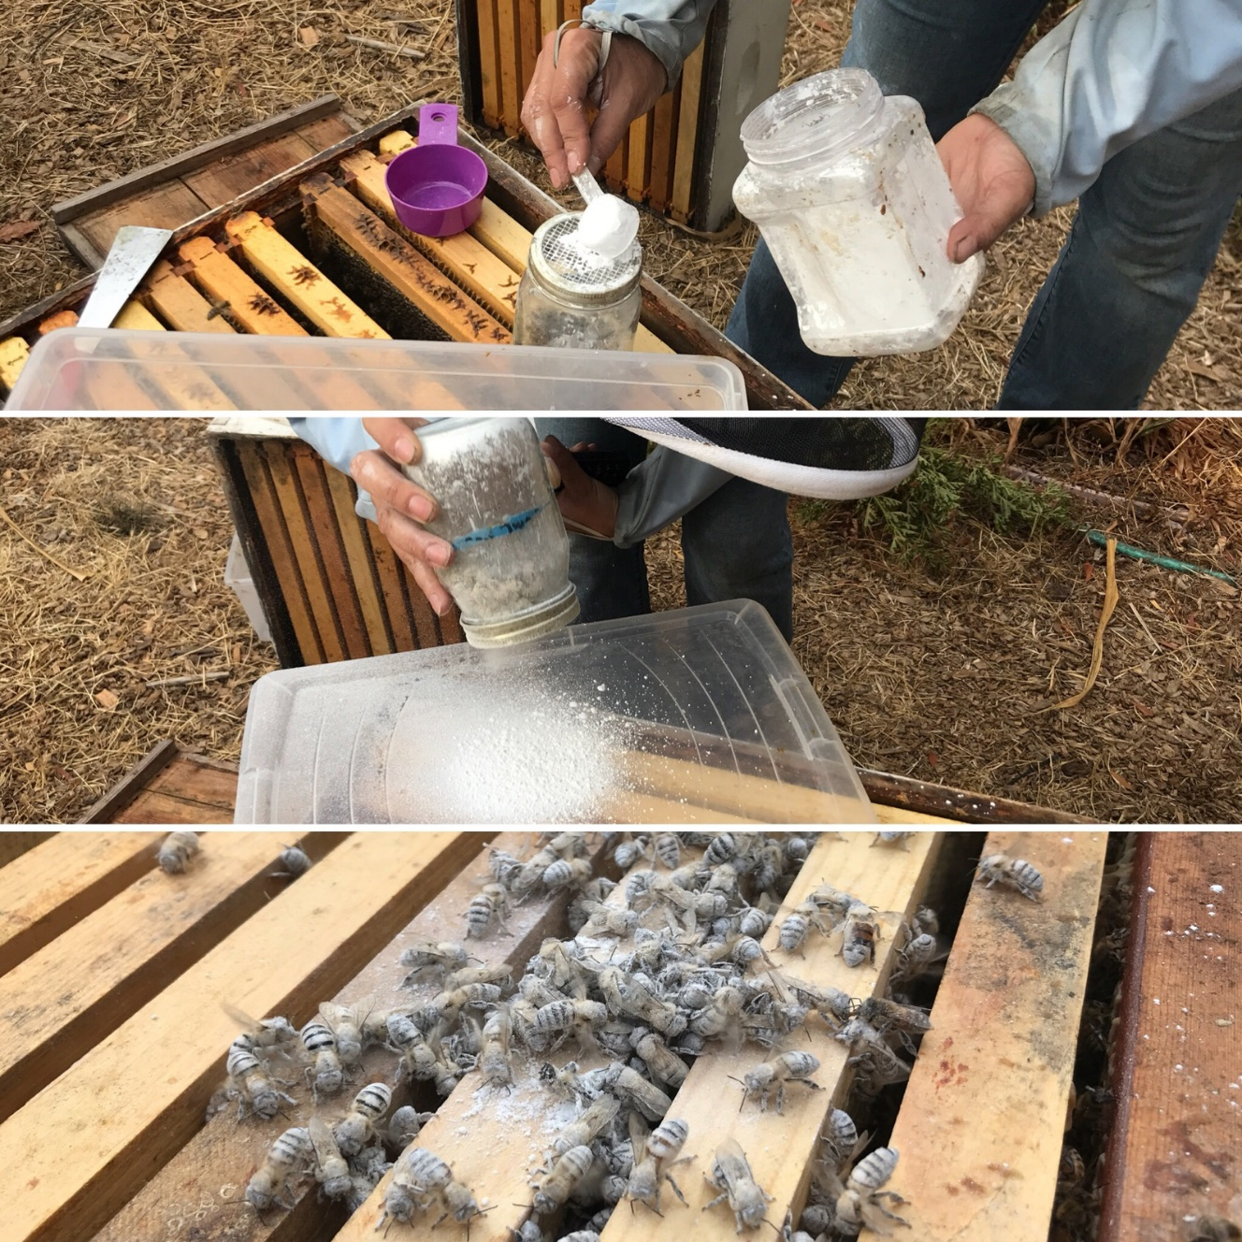
How to Participate
Data Collection (May 2-17 and August 15-30):
P2 Responded By Delivering:
Monitor the level of mites per 100 bees.
Use an alcohol wash or powdered sugar roll .
Collect data on location, total number of hives, number of hives tested, local habitat, and the number of mites counted from each hive.
Enter data on www.mitecheck.com.
Spread the Word:
Encourage beekeepers to participate and help them prepare testing kits.
Get resources at www.pollinator.org/miteathon
Questions: miteathon@pollinator.org or 415-362-1137
4

