Slide 1
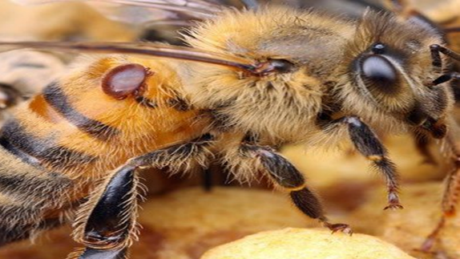
The North American Mite-A-Thon
Dates: SPRING: April 30- May 15, 2022
FALL: August 13-28, 2022
Objectives:
To raise awareness about honey bee colony Varroa infestations in North America through effective monitoring methods.
To make available management strategies for discussion within bee organizations utilizing Mite‐A‐Thon partner developed information and outreach materials.
Participants:
All beekeepers in North America are invited to participate by collecting mite infestation data in honey bee colonies.
Data:
Varroa monitoring data will be uploaded to www.mitecheck.com.
Spread the word:
Encourage beekeepers to participate and help them prepare for testing.
Get resources at www.pollinator.org/miteathon.

