Slide 1
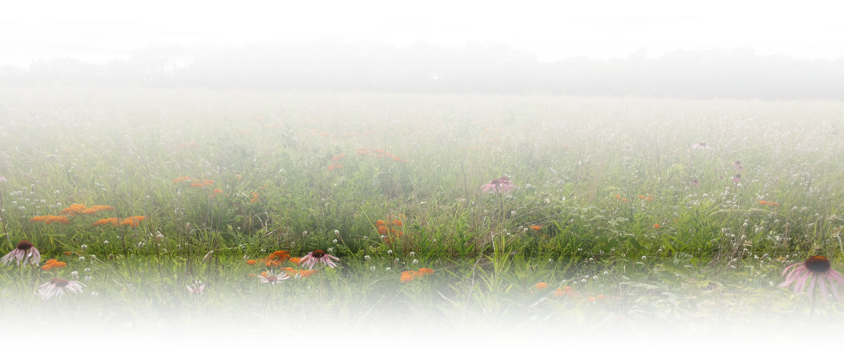
CP-43 A Pollinator Practice with A Lot of Benefits
Presented by:
Eleanor Schumacher
Illinois NRCS Liaison & Project Wingspan Illinois State Coordinator
Pollinator Partnership
Notes:
Greeting and thanks
I’m Eleanor Schumacher, I work for Pollinator Partnership as the Illinois NRCS Liaison and the Project Wingspan Illinois State Coordinator.
My husband and I are dairy farmers in Pocahontas, a little town in Southern Illinois.
I’m a gig economy conservation worker, working off the farm. Among my jobs, I also work for the Illinois Department of Agriculture as an Apiary Inspector. I’ve been a beehive inspector for 12 years. I’m also a beekeeper.
I used to work as the resource conservationist at the Madison County SWCD, down in the Illinois suburbs of St. Louis.
This gave me an appreciation for how critically important it is to incorporate pollinator habitat into our conservation farming systems.
Pollination is an ecosystem service – a system that supports life on earth. I’m going to talk a bit about the pollinator plight in this presentation, getting into some of the science that creates the understanding of what’s happening with pollinator decline and then talk about CP-43, a new USDA conservation practice that offers erosion control, water quality improvement, and in some cases, better pollination on farms.

Slide 2
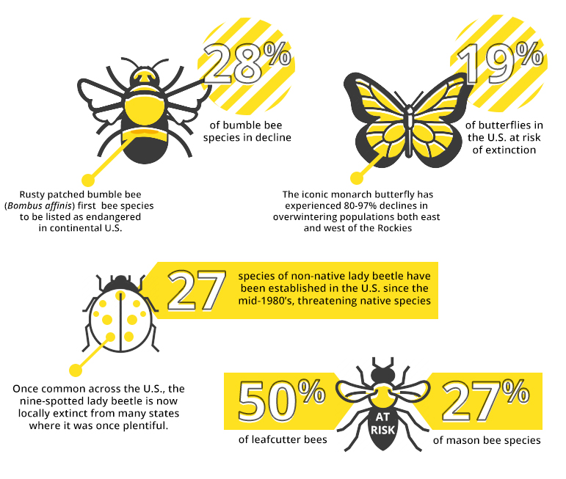
What’s happening to pollinators?
Poster: Xerces Society
Notes:
We know pollinators are in trouble, but how bad is it? What’s actually happening?
I’m going to rifle through some studies to show you the body of science that explains the importance of pollinators and the severity of pollinator decline, so hold onto your seats – this part is really exciting!
So, over the past 35 years, agricultural and natural resource agencies have noticed a rapid decline of pollinators due to several causes such as land use intensification, pesticide use, climate change, exotic and invasive species competition, and the spread of pests and diseases.
Here’s a poster put together by the Xerces Society that breaks it down, pollinator by pollinator

Slide 3
What’s happening to pollinators?
28% bumblebees in decline
Poster: Xerces Society

Slide 4
What’s happening to pollinators?
28% bumblebees in decline
19% of U.S. butterflies at risk of extinction
Poster: Xerces Society

Slide 5
What’s happening to pollinators?
28% bumblebees in decline
19% of U.S. butterflies at risk of extinction
50 % of leafcutter bee species are at risk
Poster: Xerces Society

Slide 6
What’s happening to pollinators?
28% bumblebees in decline
19% of U.S. butterflies at risk of extinction
50 % of leafcutter bees species are at risk
27% of mason bee species are at risk
Poster: Xerces Society

Slide 7
What’s happening to pollinators?
28% bumblebees in decline
19% of U.S. butterflies at risk of extinction
50 % of leafcutter bees species are at risk
27% of mason bee species are at risk
27 species of non-native lady beetles threaten our native beetles
Poster: Xerces Society
Notes:
Put this together with USDA resources that report “Numerous species of butterflies, moths, and native bees are either extremely rare or are extinct.”, we realize we have a real problem on our hands.

Slide 8
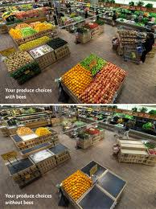
Global Food Security ~Science
Photo: Whole Foods, Share The Buzz Campaign
Notes:
But how much do these beneficial insects really matter to our world and society?
It’s taken decades of research to actually identify the value of pollinators to human life. The research is ongoing. A focus on food security is key to helping the world understand what’s at stake.
These are figures that researchers agree on.
READ SLIDE

Slide 9
Global Food Security ~Science
75% of global food crops depend on pollinators (Klein et al. 2005, IPBES 2016)
Photo: Whole Foods, Share The Buzz Campaign

Slide 10
Global Food Security ~Science
75% of global food crops depend on pollinators (Klein et al. 2005, IPBES 2016)
1 out of 3 bites of food we eat are because a pollinator visited a flower (McGregor 1976, Buchmann and Nabhan 1997)
Photo: Whole Foods, Share The Buzz Campaign

Slide 11
Global Food Security ~Science
75% of global food crops depend on pollinators (Klein et al. 2005, IPBES 2016)
1 out of 3 bites of food we eat are because a pollinator visited a flower (McGregor 1976, Buchmann and Nabhan 1997)
Declines in production are associated with pollinator decline (Klein et al. 2005)
Photo: Whole Foods, Share The Buzz Campaign
Notes:
On the right, you see what’s now a well known picture. This is from Whole Foods Share the Buzz Campaign, a collaboration with Xerces Society in 2013.
Here’s a better look at those pictures.

Slide 12
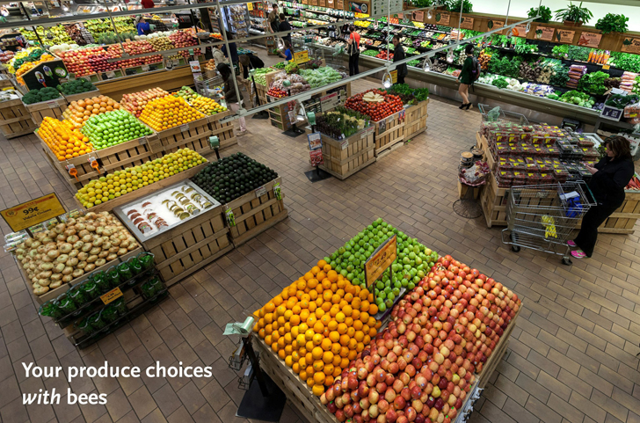
Photo: Whole Foods, Share The Buzz Campaign

Slide 13
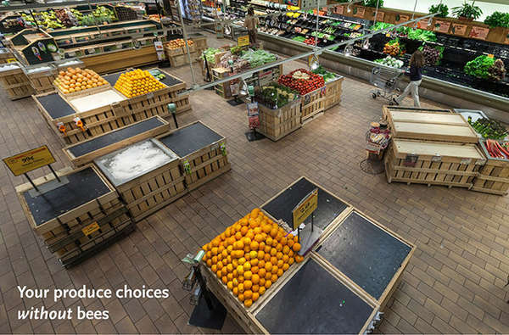
Photo: Whole Foods, Share The Buzz Campaign

Slide 14
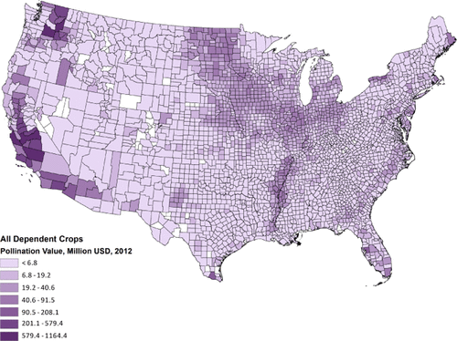
Economic Value of Pollination
Jordan et al. 2021
Notes:
And NOW, get ready for some more exciting science!
Here are just a few studies that have shown what’s at stake.

Slide 15
Economic Value of Pollination
84% of European crops depend on animal pollination (Williams 1994)
Jordan et al. 2021
Notes:
A 1994 study showed 84% of European crops depend on animal pollination

Slide 16
Economic Value of Pollination
84% of European crops depend on animal pollination (Williams 1994)
$6.8 billion from honeybees in US $3.1 billion for native bees in US (Losey and Vaughan 2003)
Jordan et al. 2021
Notes:
A 2003 study broke down the economic worth of honey bee pollination and native bee pollination to US agriculture.
They estimated 6.8 billion dollars were attributed to honeybee pollination, and 3.1 billion to native bees.

Slide 17
Economic Value of Pollination
84% of European crops depend on animal pollination (Williams 1994)
$6.8 billion from honey bees in US $3.1 billion for native bees in US (Losey and Vaughan 2003)
$217 billion global crop production from insect pollination (Gallai et al. 2008)
Jordan et al. 2021
Notes:
A 2008 study estimated global crop production from insect pollination was worth 217 billion dollars

Slide 18
Economic Value of Pollination
84% of European crops depend on animal pollination (Williams 1994)
$6.8 billion from honey bees in US $3.1 billion for native bees in US (Losey and Vaughan 2003)
$217 billion global crop production from insect pollination (Gallai et al. 2008)
Most vulnerable: 1st – counties producing fruit & nuts 2nd – melons, vegetables 3rd – oil seed (canola/soybean)
(Jordan et al. 2021)
Jordan et al. 2021
Notes:
And now this study published last year, the study that gives us this county-by-county map. It shows the counties most vulnerable based on the type of pollinator mediated foods they produce, but also based on the scale of pollinator decline in that region.
Most vulnerable – in first place, counties producing fruit and nuts. You see the dark spots on the West Coast.
In 2nd place, counties producing melons and vegetables. Do you know any counties producing that?
In 3rd place, counties producing oil seed, like canola and soybean. Now can you think of any counties?
You see Illinois has color. Illinois is the number one state for pumpkin export, and of course, a big soybean exporter. But we have extremely low acreage of pollinator habitat, and steep pollinator decline. That makes our production vulnerable to pollinator loss.

Slide 19
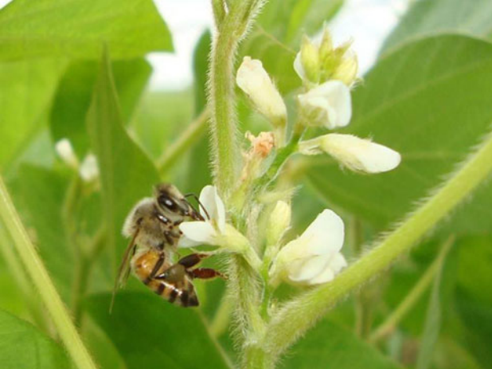
Does this really matter to YOU?
Rocha & Freitas
Notes:
READ SLIDE

Slide 20
Does this really matter to YOU?
Illinois corn/beans rotation –
Does it need pollinators?
Rocha & Freitas
Notes:
1. But how does this apply to your farm? Sure! My farm is a dairy farm! We grow alfalfa! Bees pollinate alfalfa. But guess what? Bees can make a difference to your soybeans. And soybeans can be a great nectar source for bees. Several common varieties yield nectar and honey for bees.

Slide 21
Bees CAN Increase Crop Yields
Rocha & Freitas
Notes:
Here’s some science on that. The last of the science I’ll have today.

Slide 22
Bees CAN Increase Crop Yields
Soybean yields between 6% and 18% higher with bees (Rocha & Freitas, 2013)
Rocha & Freitas
Notes:
This study found soybean yields were significantly increased by honeybees and wild bees.
Soybean yields were between 6% and 18% higher with bees.

Slide 23
Bees CAN Increase Crop Yields
Soybean yields between 6% and 18% higher with bees (Rocha & Freitas, 2013)
Contribution of honeybees to soybean yield – 18% (Bletter et al. 2017)
Rocha & Freitas
Notes:
This 2017 study found honeybees increased soybean yield by 18%

Slide 24
Bees CAN Increase Crop Yields
Soybean yields between 6% and 18% higher with bees (Rocha & Freitas, 2013)
Contribution of honeybees to soybean yield (Bletter et al. 2017)
Pollination by Non-Apis Bees and Potential Benefits in Self-Pollinating Crops (Esquivel et al. 2021)
Rocha & Freitas
Notes:
Just published last year is an extensive review of all the studies investigating the influence of pollinators on self pollinating crops like soybeans, cotton, coffee, and canola. It showed benefits from native bees, and called for more study.

Slide 25
Bees CAN Increase Crop Yields
Soybean yields between 6% and 18% higher with bees (Rocha & Freitas, 2013)
Contribution of honeybees to soybean yield (Bletter et al. 2017)
Pollination by Non-Apis Bees and Potential Benefits in Self-Pollinating Crops (Esquivel et al. 2021)
Identification of Plant Species for Crop Pollinator Habitat Enhancement in the Northern Prairies (Robson 2014)
Rocha & Freitas
Notes:
Finally, a 2014 study that tips off the benefits of adding prairies to farm margins.
This study looked at native bees on canola in Manitoba.
They suggest growing wildflowers adjacent to canola field margins to increase canola yields.
They found the system of pollination significantly strengthened with benefits to the crops when pollinator habitat was planted nearby.
This study highlights an extremely important concept – that pollination is a system that revolves around diverse populations of native bees and native wildflowers, all benefitting from each other.

Slide 26
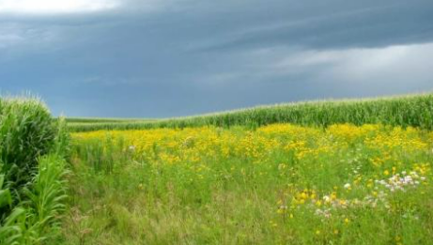
Prairie Strips Study, Iowa State University
Iowa State University
Notes:
Put these studies together with studies that show how pollinator habitat incorporated into cropland can make on-farm improvements, and we have new methods of conservation.
We have a new conservation practice that has SEVERAL applications for row crop farms.
Prairie Strips, also known as CP-43, made their debut in 2017. A now famous Prairie Strips study from University of Iowa showed amazing benefits from planting pollinator habitat on farms, a real winner.

Slide 27
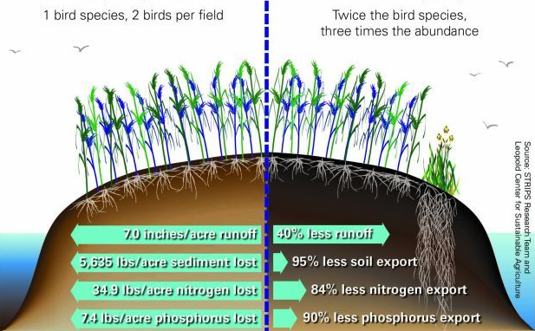
Prairie Strips Study, Iowa State University
Grudens-Schuck, et al. (2017)
Prairie Strips Study Results
Notes:
Here’s a look at the results.
READ SLIDES

Slide 28
Prairie Strips Study, Iowa State University
Grudens-Schuck, et al. (2017)
Prairie Strips Study Results
44% reduction in water runoff
Notes:
Here’s a look at the results.
READ SLIDES

Slide 29
Prairie Strips Study, Iowa State University
Grudens-Schuck, et al. (2017)
Prairie Strips Study Results
44% reduction in water runoff
95% reduction in soil loss
Notes:
Here’s a look at the results.
READ SLIDES

Slide 30
Prairie Strips Study, Iowa State University
Grudens-Schuck, et al. (2017)
Prairie Strips Study Results
44% reduction in water runoff
95% reduction in soil loss
90% reduction in phosphorus runoff
Notes:
Here’s a look at the results.
READ SLIDES

Slide 31
Prairie Strips Study, Iowa State University
Grudens-Schuck, et al. (2017)
Prairie Strips Study Results
44% reduction in water runoff
95% reduction in soil loss
90% reduction in phosphorus runoff
84% reduction in nitrate- nitrogen runoff
Notes:
Here’s a look at the results.
READ SLIDES

Slide 32
Prairie Strips Study, Iowa State University
Grudens-Schuck, et al. (2017)
Prairie Strips Study Results
44% reduction in water runoff
95% reduction in soil loss
90% reduction in phosphorus runoff
84% reduction in nitrate- nitrogen runoff
No difference in per acre corn and soybean yields
Notes:
Here’s a look at the results.
READ SLIDES

Slide 33
Prairie Strips Study, Iowa State University
Grudens-Schuck, et al. (2017)
Prairie Strips Study Results
44% reduction in water runoff
95% reduction in soil loss
90% reduction in phosphorus runoff
84% reduction in nitrate- nitrogen runoff
No difference in per acre corn and soybean yields
Weed abundance did not increase
Notes:
Now that’s all great news, but if you were disappointed reading there was no difference in soybean yields, its not bad news.
It showed that incorporating pollinator habitat into crop fields didn’t reduce yields. That’s a positive.

Slide 34
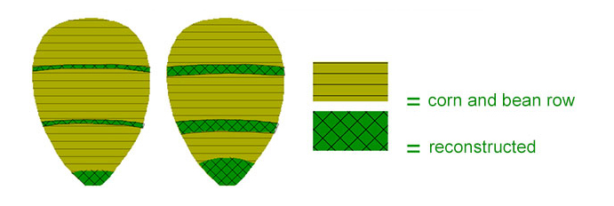
What’s Involved? How to Get Started?
Iowa Agriculture Water Alliance
Notes:
How do you get started?

Slide 35
What’s Involved? How to Get Started?
Conservation Plan from your USDA field office
Iowa Agriculture Water Alliance
Notes:
Visit your local USDA field office and schedule time with a conservation planner.
You can identify exactly what problems you’re having on your fields and where, and how much field it makes sense to convert.
READ SLIDE

Slide 36
What’s Involved? How to Get Started?
Conservation Plan from your USDA field office
Identify areas of soil vulnerability and lower productivity
Iowa Agriculture Water Alliance
Notes:
How do you get started? Visit your local USDA field office and schedule time with a conservation planner.
You can identify exactly what problems you’re having on your fields and where, and how much field it makes sense to convert.
READ SLIDE

Slide 37
What’s Involved? How to Get Started?
Conservation Plan from your USDA field office
Identify areas of soil vulnerability and lower productivity
Strategic prairie strip placement, not unlike terraces
Iowa Agriculture Water Alliance
Notes:
How do you get started? Visit your local USDA field office and schedule time with a conservation planner.
You can identify exactly what problems you’re having on your fields and where, and how much field it makes sense to convert.
READ SLIDE

Slide 38
What’s Involved? How to Get Started?
Conservation Plan from your USDA field office
Identify areas of soil vulnerability and lower productivity
Strategic prairie strip placement, not unlike terraces
Usually 30 feet wide and perpendicular to water courses
Iowa Agriculture Water Alliance
Notes:
How do you get started? Visit your local USDA field office and schedule time with a conservation planner.
You can identify exactly what problems you’re having on your fields and where, and how much field it makes sense to convert.
READ SLIDE

Slide 39
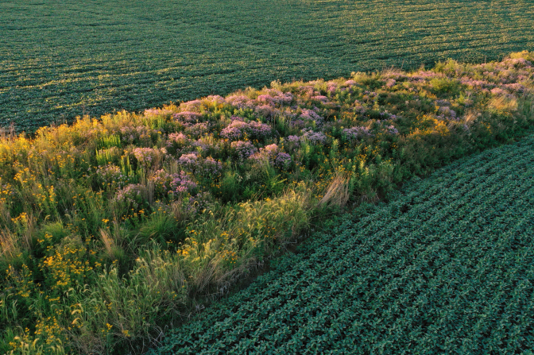
USDA Standards and Specs
Iowa State University
Notes:
You’ll have to follow established USDA guidelines. Your conservation planner will design your seed mix, making sure…
READ SLIDE

Slide 40
USDA Standards and Specs
Minimum of 10 native flowering plants.
Iowa State University
Notes:
You’ll have to follow some USDA guidelines. Your conservation planner will design your seed mix, making sure…
READ SLIDE

Slide 41
USDA Standards and Specs
Minimum of 10 native flowering plants.
At least two species will be blooming for each bloom period (early, mid, and late flowering seasons)
Iowa State University
Notes:
You’ll have to follow some USDA guidelines. Your conservation planner will design your seed mix, making sure…
READ SLIDE

Slide 42
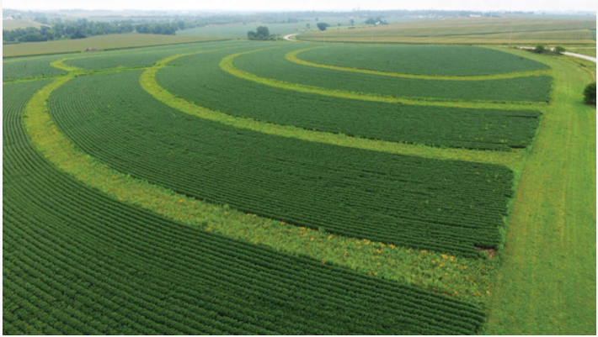
Establishment and Management
Iowa State University
Notes:
After you broadcast your seeds, mowing is critical for a successful prairie establishment
In the first year, prairie roots are growing down while weeds are growing up…
READ SLIDE

Slide 43
Establishment and Management
MOWING!!! The Key to Success!
Iowa State University
Notes:
After you broadcast your seeds, mowing is critical for a successful prairie establishment
In the first year, prairie roots are growing down while weeds are growing up…
READ SLIDE

Slide 44
Establishment and Management
MOWING!!! The Key to Success!
Year One: Mow 4 to 6 inches, 3 to 4 times
Iowa State University
Notes:
Year one – every time weeds are knee high, mow the prairie down to 4 to 6 inches. Most people have to do this 3 to 4 times in that first season
READ SLIDE

Slide 45
Establishment and Management
MOWING!!! The Key to Success!
Year One: Mow 4 to 6 inches, 3 to 4 times
Year Two: Mow 8 to 10 inches, 2 to 3 times
Iowa State University
Notes:
READ SLIDE

Slide 46
Establishment and Management
MOWING!!! The Key to Success!
Year One: Mow 4 to 6 inches, 3 to 4 times
Year Two: Mow 8 to 10 inches, 2 to 3 times
Year Three: Options
Spot-treat weeds/shrubs with herbicide
Controlled burn
Iowa State University
Notes:
READ SLIDE

Slide 47
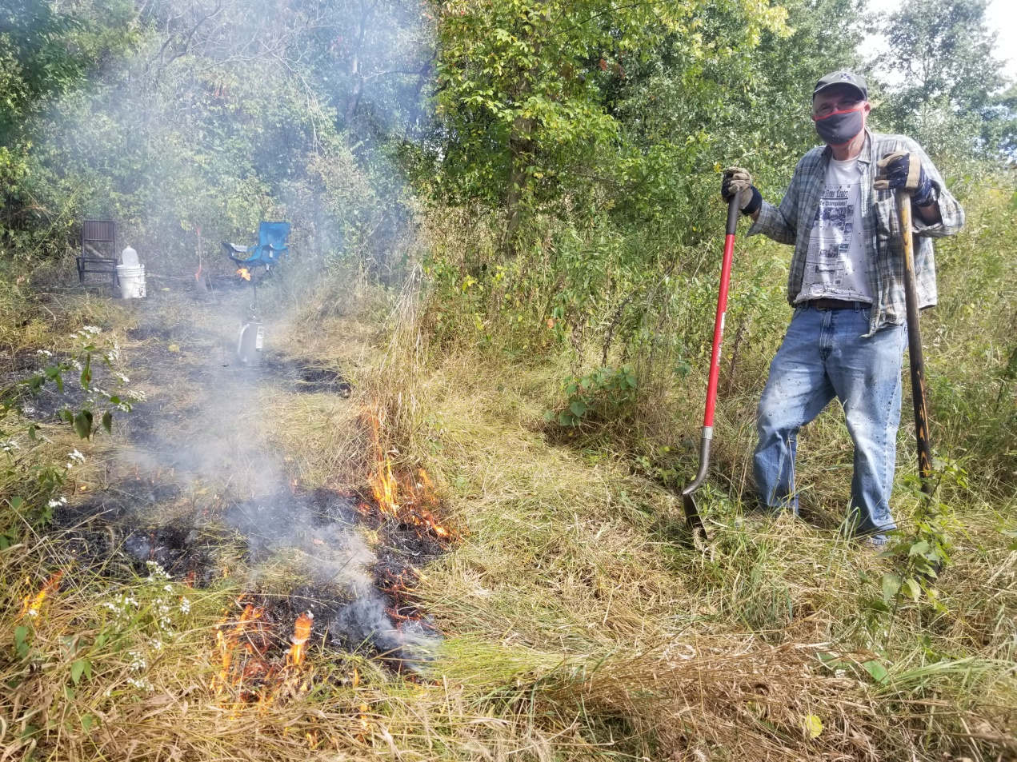
Prescribed Burn
Notes:
Prescribed burning is great prairie management
Not just because it’s the most effective, but because its really fun, especially when you take a course, get certified, and do it with others.
Here’s my friend Larry, the master naturalist. This was at the beginning of his first burn at my prairie back in 2020. See him wearing his mask outside.

Slide 48
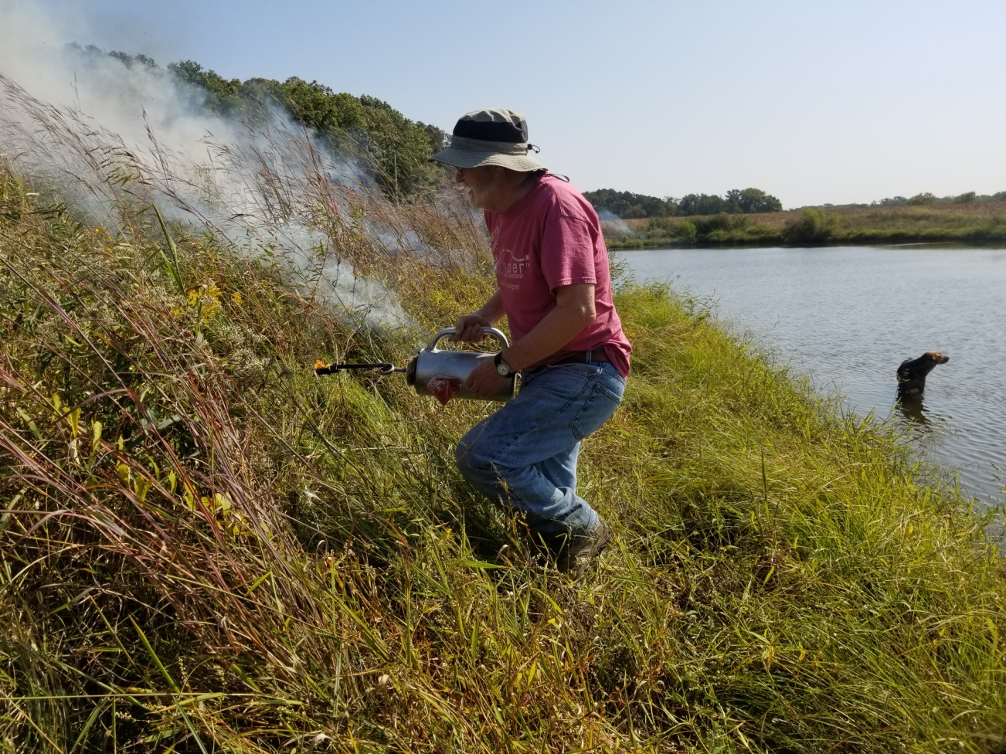
Prescribed Burn
Notes:
Here’s Larry at his second burn about a week later. Really getting into it. It was hard to stop him. But we had a burn plan.
Don’t burn your prairie without a burn plan. Your USDA field office will help you with that.

Slide 49
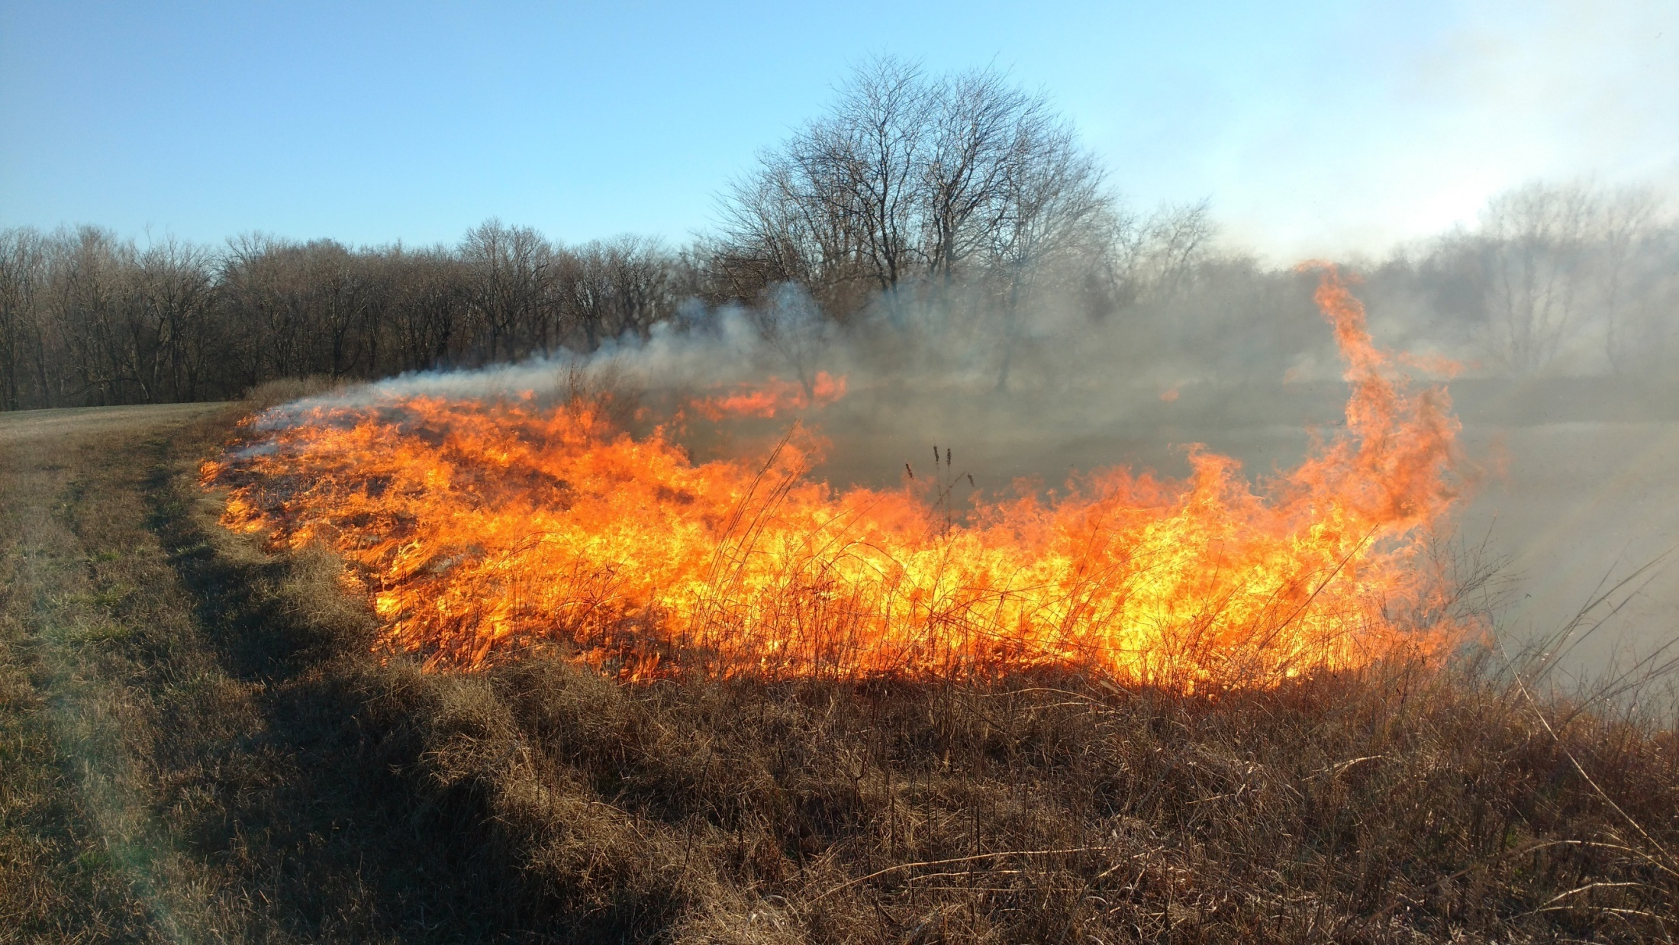
Prescribed Burn
Iowa State University
Notes:
Prescribed Burning isn’t the only way to manage a prairie
But it helps increase the vigor of the prairie
It helps control non-desired species, and helps forbs get better established by removing thatch.

Slide 50
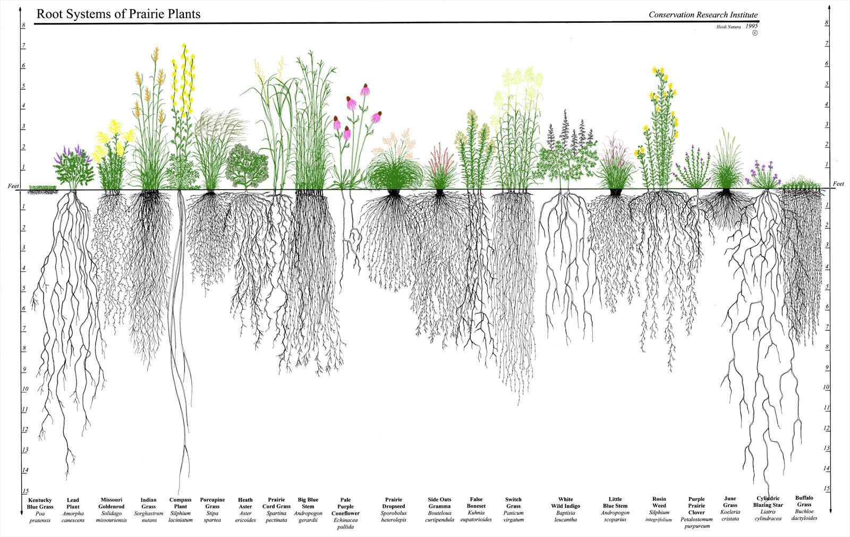
Notes:
Prairies are a very rewarding conservation practice.
Installing CP-43 Prairie Strips can not only address soil erosion and improve water quality,
it can restore ecological heritage to your farm. That’s something to be proud of and enjoy in your heart and soul.

Slide 51
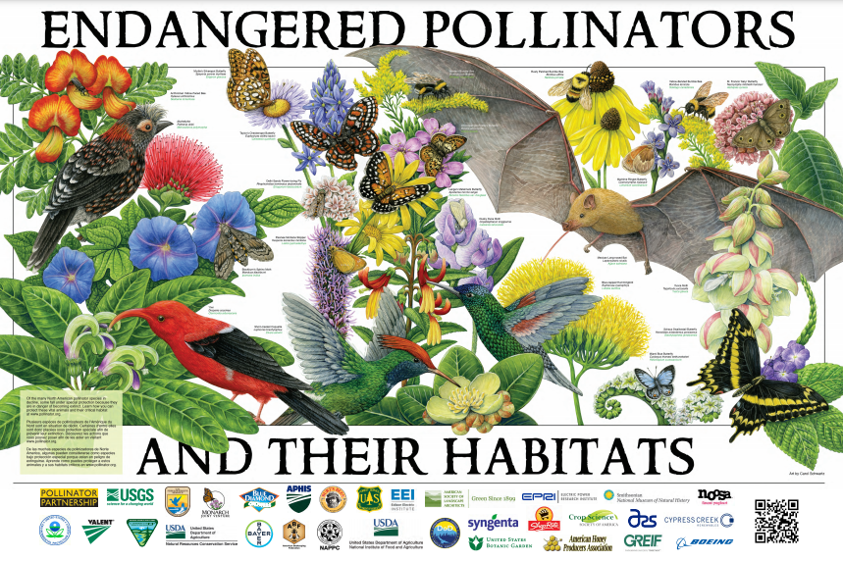
Notes:
If you would like to talk more about pollinators and pollinator habitat, please don’t be shy.

Slide 52
Come Get Involved!
Notes:
Pollinator Partnership, the not-for-profit organization I work with, has all kinds of programs and opportunities to save pollinators. Here’s a visual glance at some of the many projects and resources we offer.

Slide 53
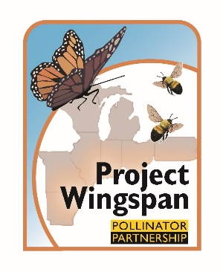
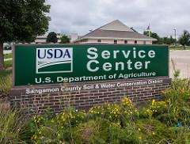
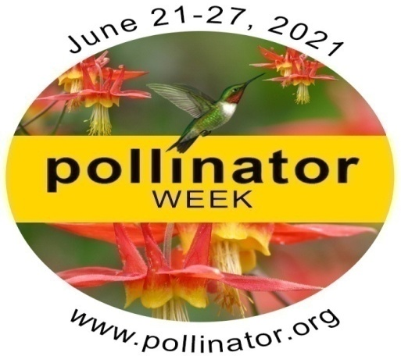
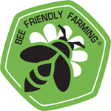
Look for these ways to engage!
Notes:
Please do visit your local USDA Service Center to learn more about pollinator habitat for your farm.
If you want to help pollinators even more, Pollinator Partnership can complement your involvement in USDA programs by certifying your farm as a Bee Friendly Farm – BFF. Use of our BFF logo and your certification may add value to the crops you grow and sell from your farm.
And if you like visiting prairies and you want to learn about seeds and help improve pollinator habitat in Illinois, you can help me by getting involved with Project Wingspan
I’m seeking seed collection volunteers and prairies where we’ll collect native wildflower seeds for the 2022 season. The seeds we collect, we award to local pollinator habitat projects. It’s a labor of love and a lot of fun.

Slide 54
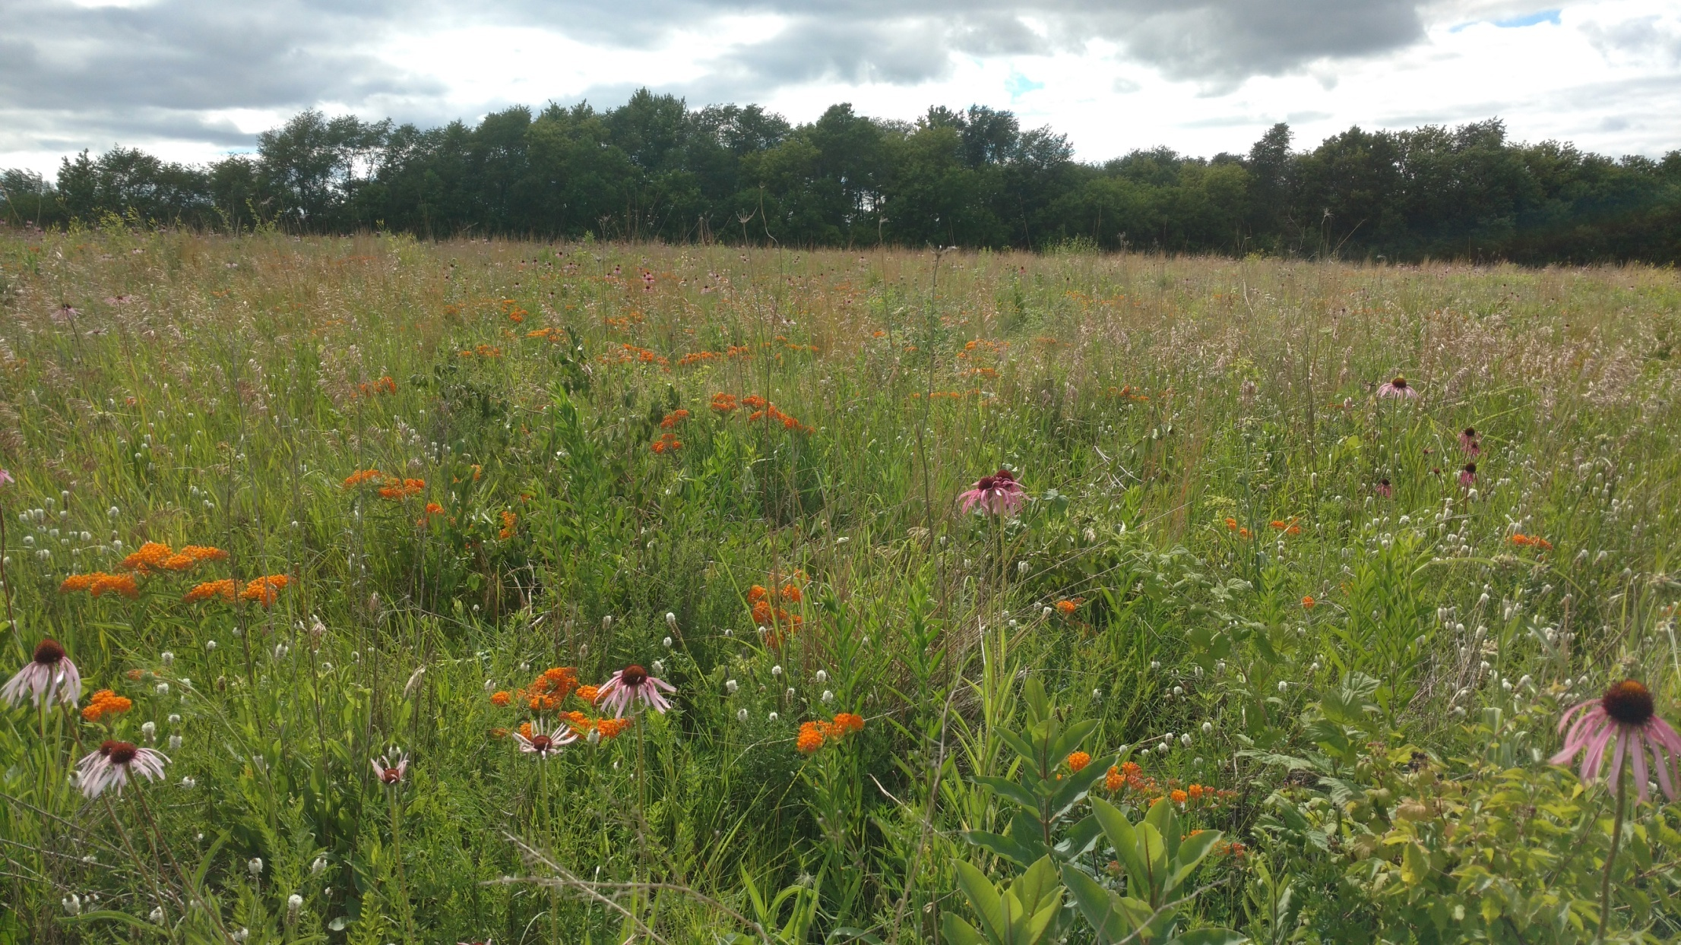
Thank You!
Notes:
Thank you

