Slide 1
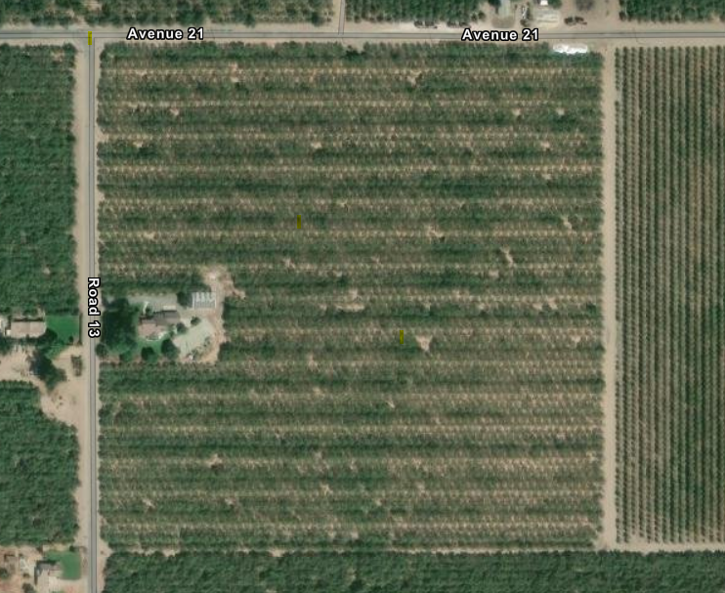
Water source district canal
Cover crops planted every row
Hedgerows planted around house and natural gardening and flowering habitat.
Water source from bee buckets

