Slide 1
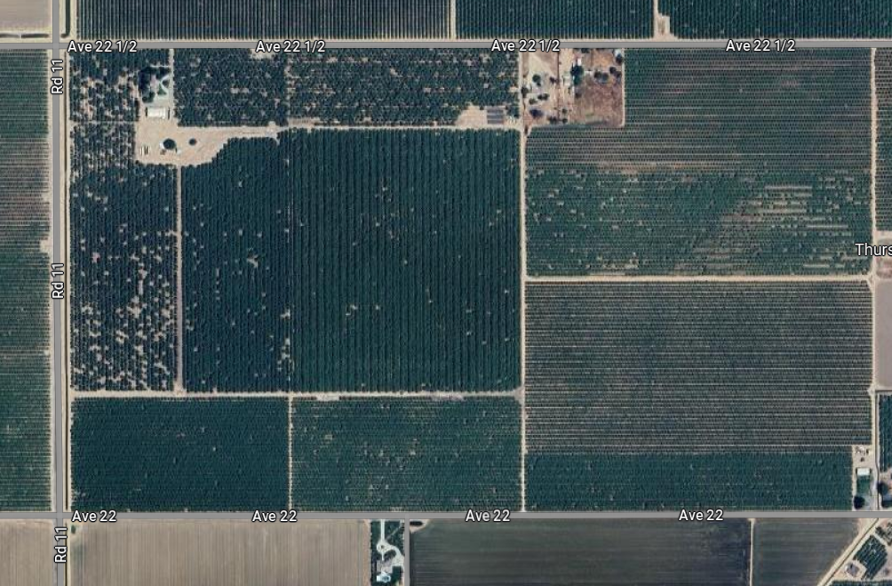
Hedgerows planted around solar panels
Freshwater provided by canal with irrigation district
Cover crop planted in every row in orchards circled in red
Freshwater provided by bee buckets in all orchards (10 – 15 gallon buckets throughout orchards)

